Slide 1
The nature of data: sequencing of amplicons vs shotgun metagenomes
http://merenlab.org/momics
Notes:
The purpose of the following slides is to highlight major differences between amplicon sequencing (primarily 16S ribosomal RNA gene sequences) and shotgun metagenomics.

Slide 2
The nature of data: sequencing of amplicons vs shotgun metagenomes
http://merenlab.org/momics

Slide 3
Notes:
The main principle behind amplicon sequencing is the use of primers to ‘amplify’ sequences from evolutionarily homologous and short regions of genomes of interest.
Advantages of amplicon sequencing include the affordability of this strategy, well-established primers for many environments, and the tractability of the resulting data.

Slide 4
Notes:
If we are working with an environment with, say three different populations,

Slide 5
Notes:
Our primers will land and amplify reads from each of these populations.

Slide 6
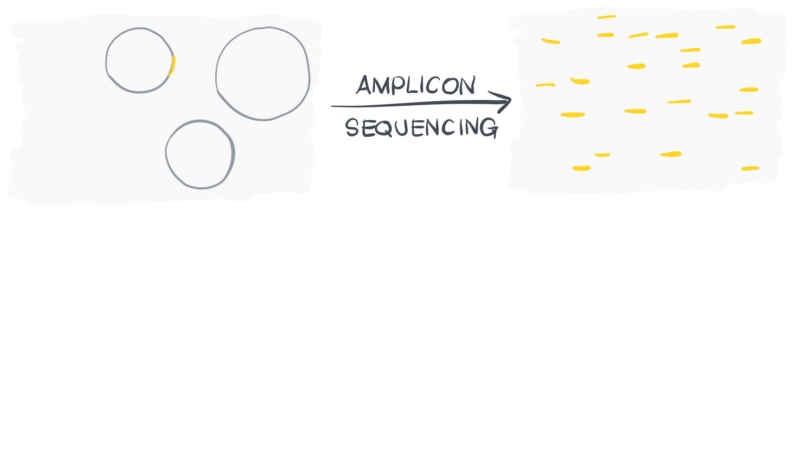

Slide 7
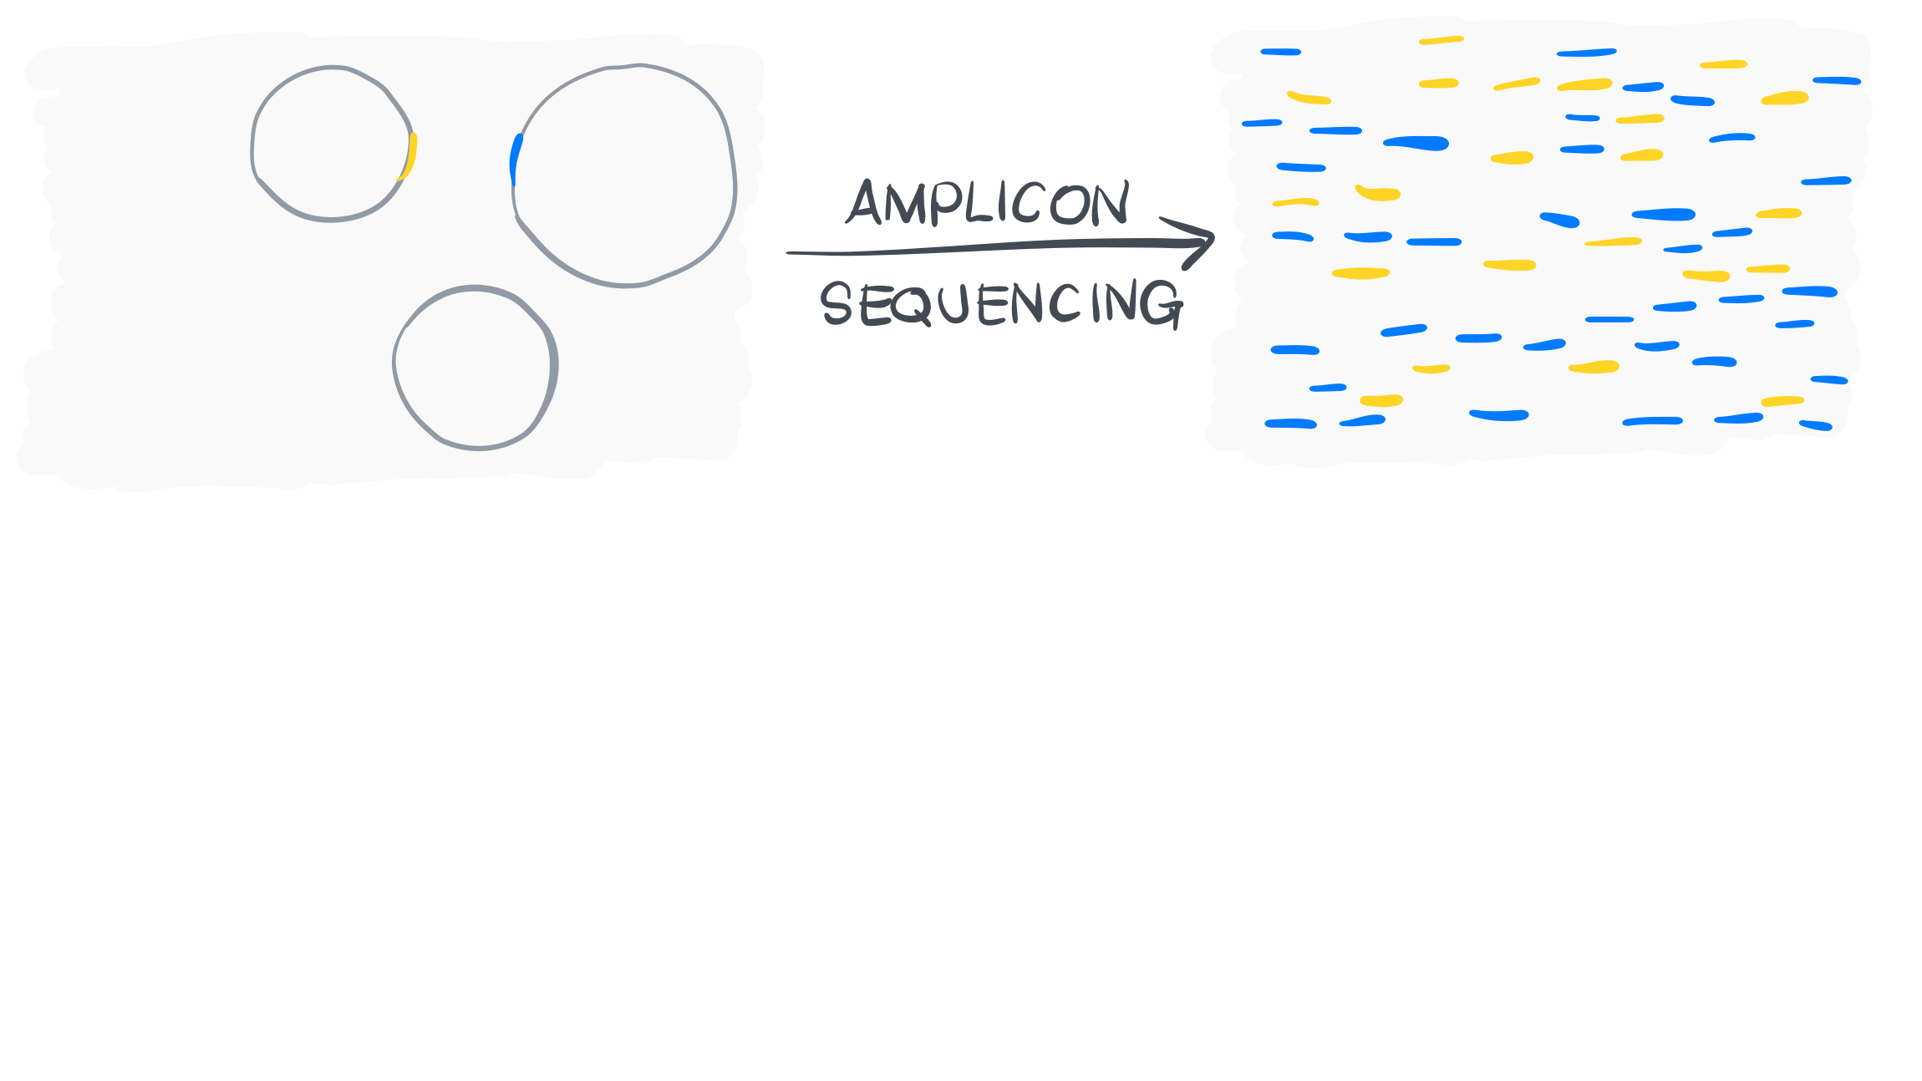

Slide 9
Notes:
The resulting dataset can be used to understand the taxonomic make up of an environment, and/or study the changes in microbial diversity as a function of environmental variables.
Although, universal primers used to amplify from 16S rRNA gene amplicon are not as universal as we would like to think. So it is likely that amplicon data will be missing information from,

Slide 10
Notes:
Bacterial populations that our primers do not recognize,

Slide 11
Notes:
Eukaryotic organisms, the ribosomal small subunit of which do not include 16S rRNA gene (but 18S rRNA gene),

Slide 12
Notes:
Plasmids,

Slide 13
Notes:
And phages.
To what extent these genetic features of a given environment is critical to understand ecosystem functioning is a an important question. And the answer may differ from study to study.

Slide 14
The nature of data: sequencing of amplicons vs shotgun metagenomes
http://merenlab.org/momics
Notes:
The alternative approach is the shotgun metagenomics.

Slide 16
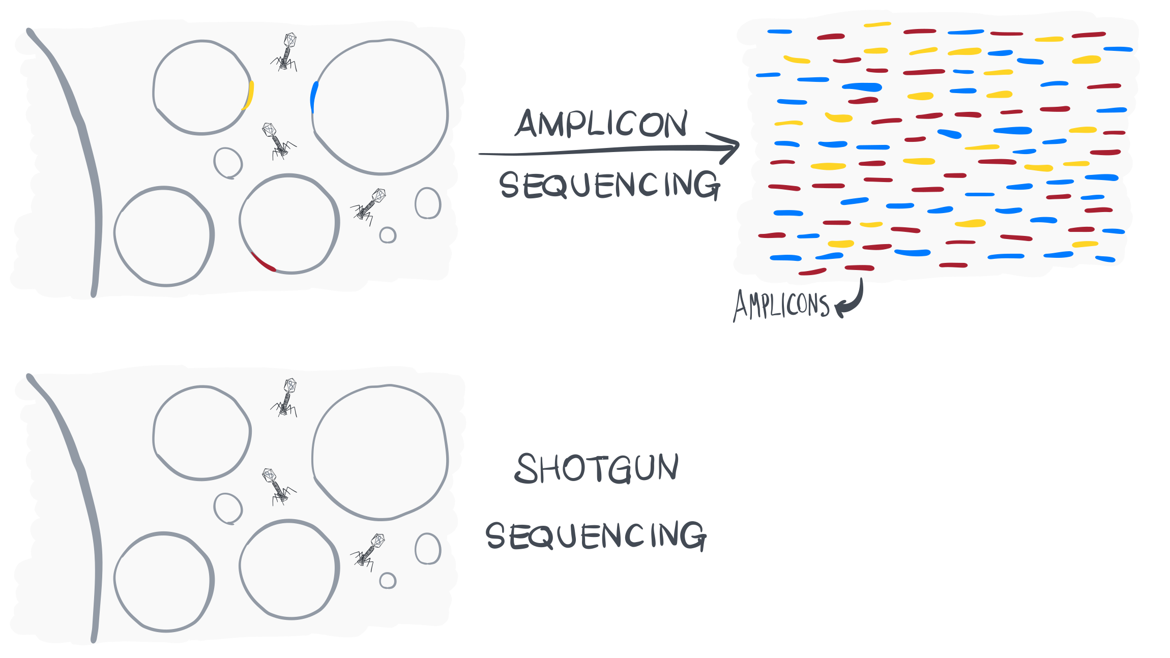

Slide 17
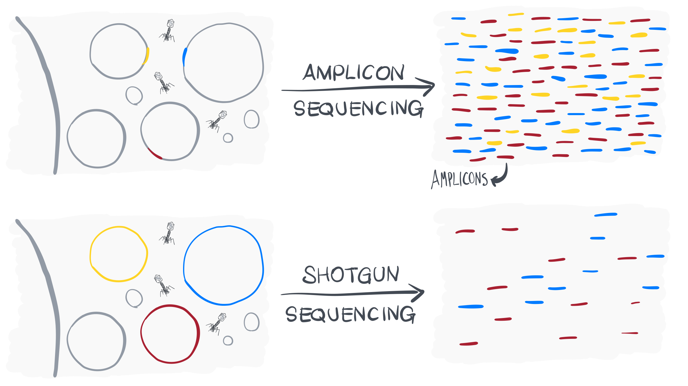

Slide 18
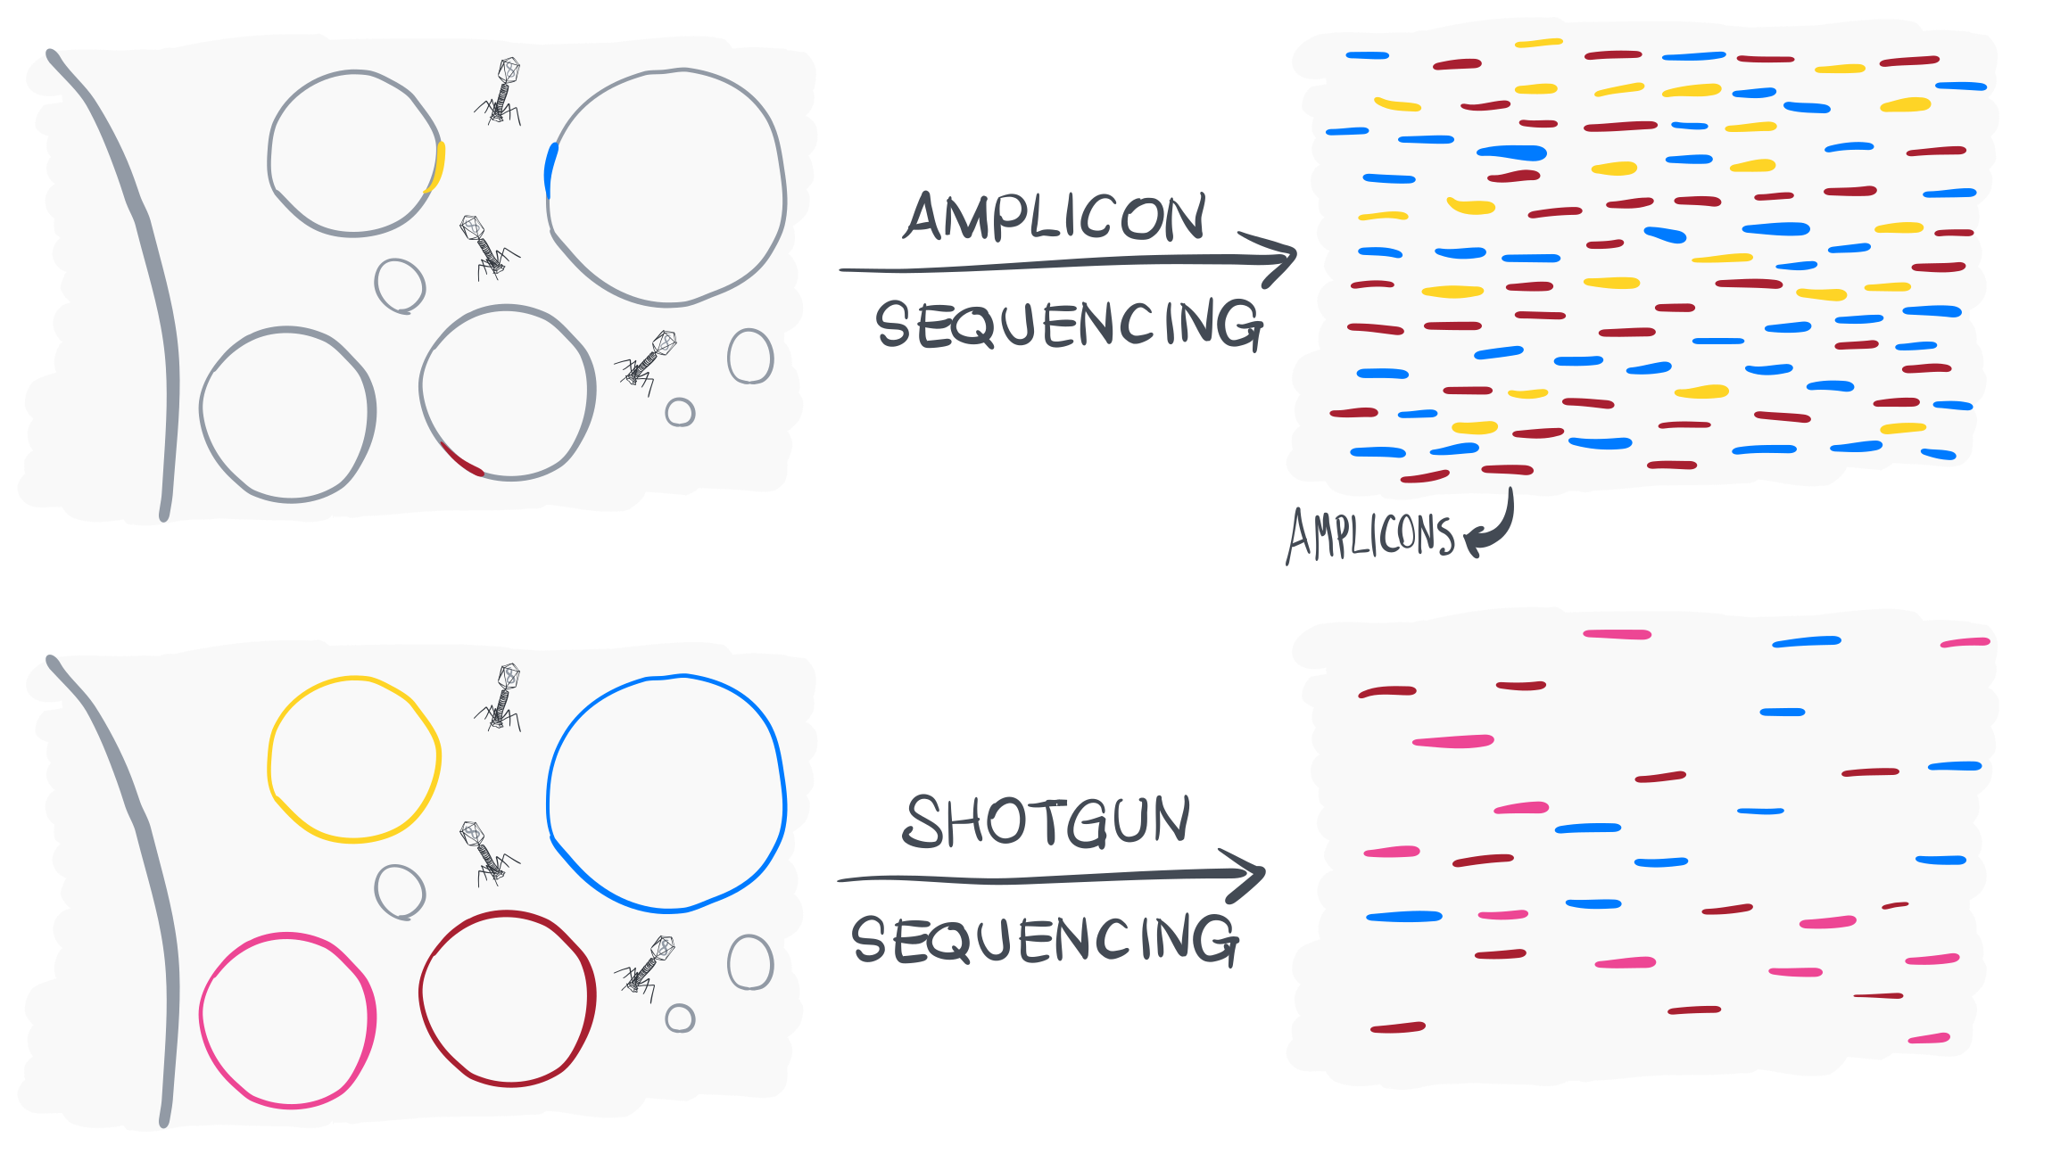

Slide 19
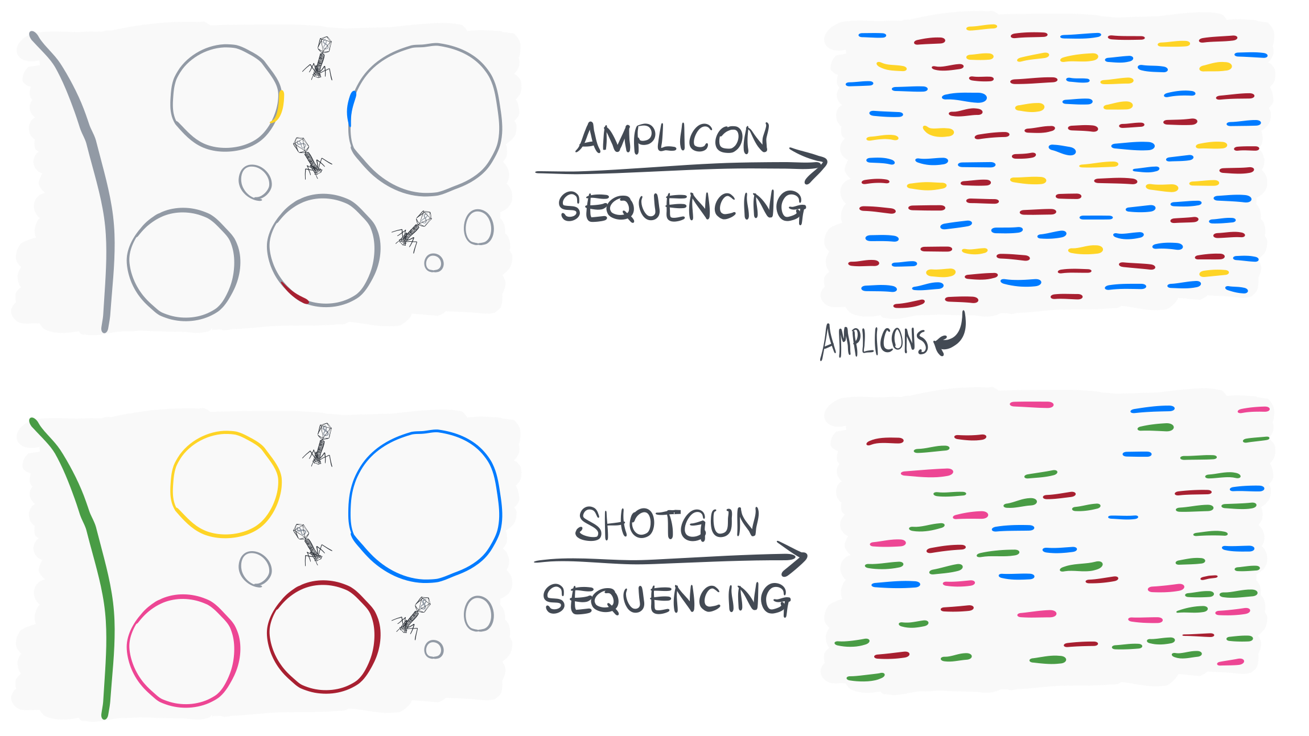

Slide 20
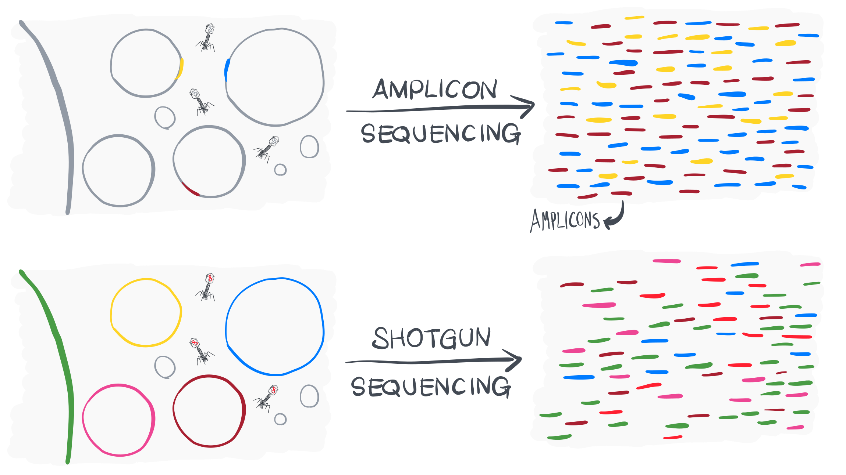

Slide 21
