Slide 1
‘Recruiting’ reads from a metagenome
http://merenlab.org/momics
Notes:
Metagenomic read recruitment is one of the most commonly used strategies in microbial ‘omics. The next few slides aim to give a sense of what is happening when a mapping software ‘recruits’ metagenomic reads using a genomic context, and how do those reads distribute throughout the genome.
While the slides demonstrate the most simple way to show that, it is important to remember (and remind everyone) that the actual read recruitment strategy will depend on the program used for this task and the parameters set by the user.

Slide 3
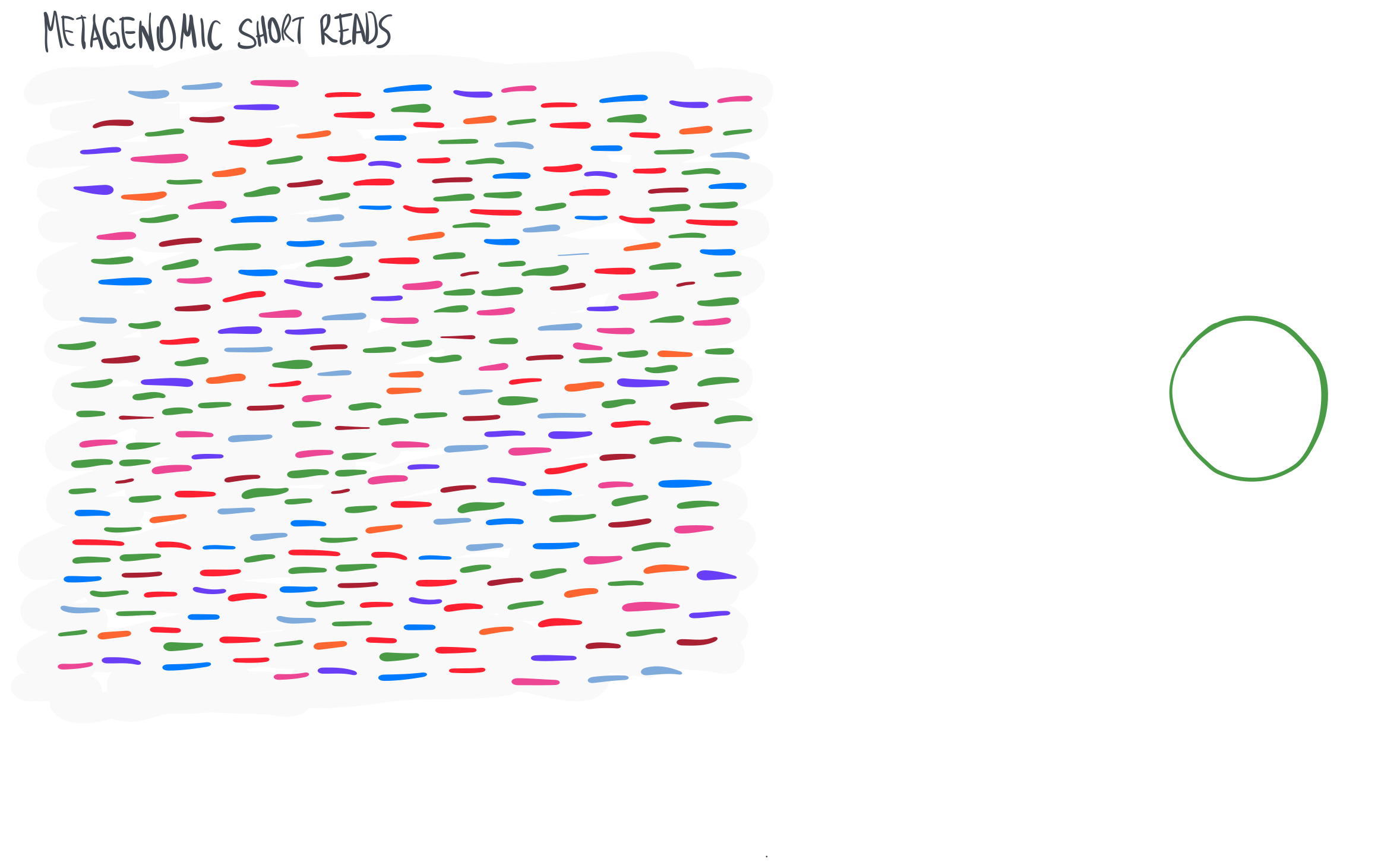

Slide 4
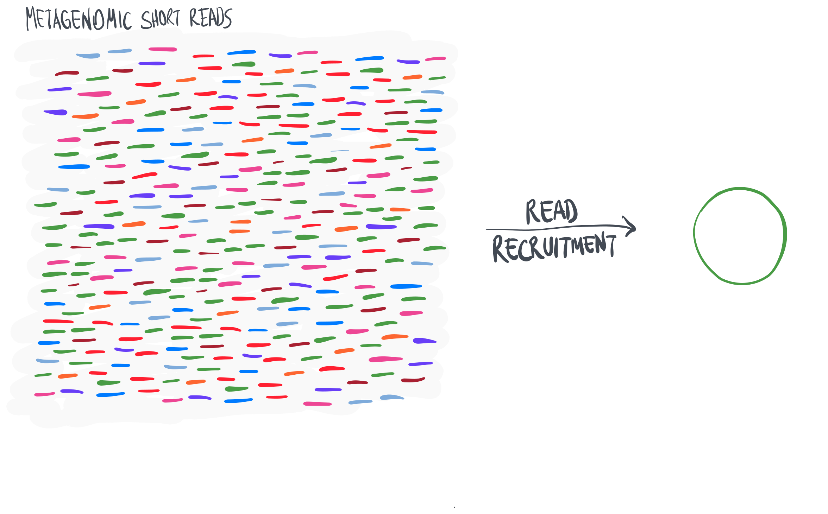

Slide 5
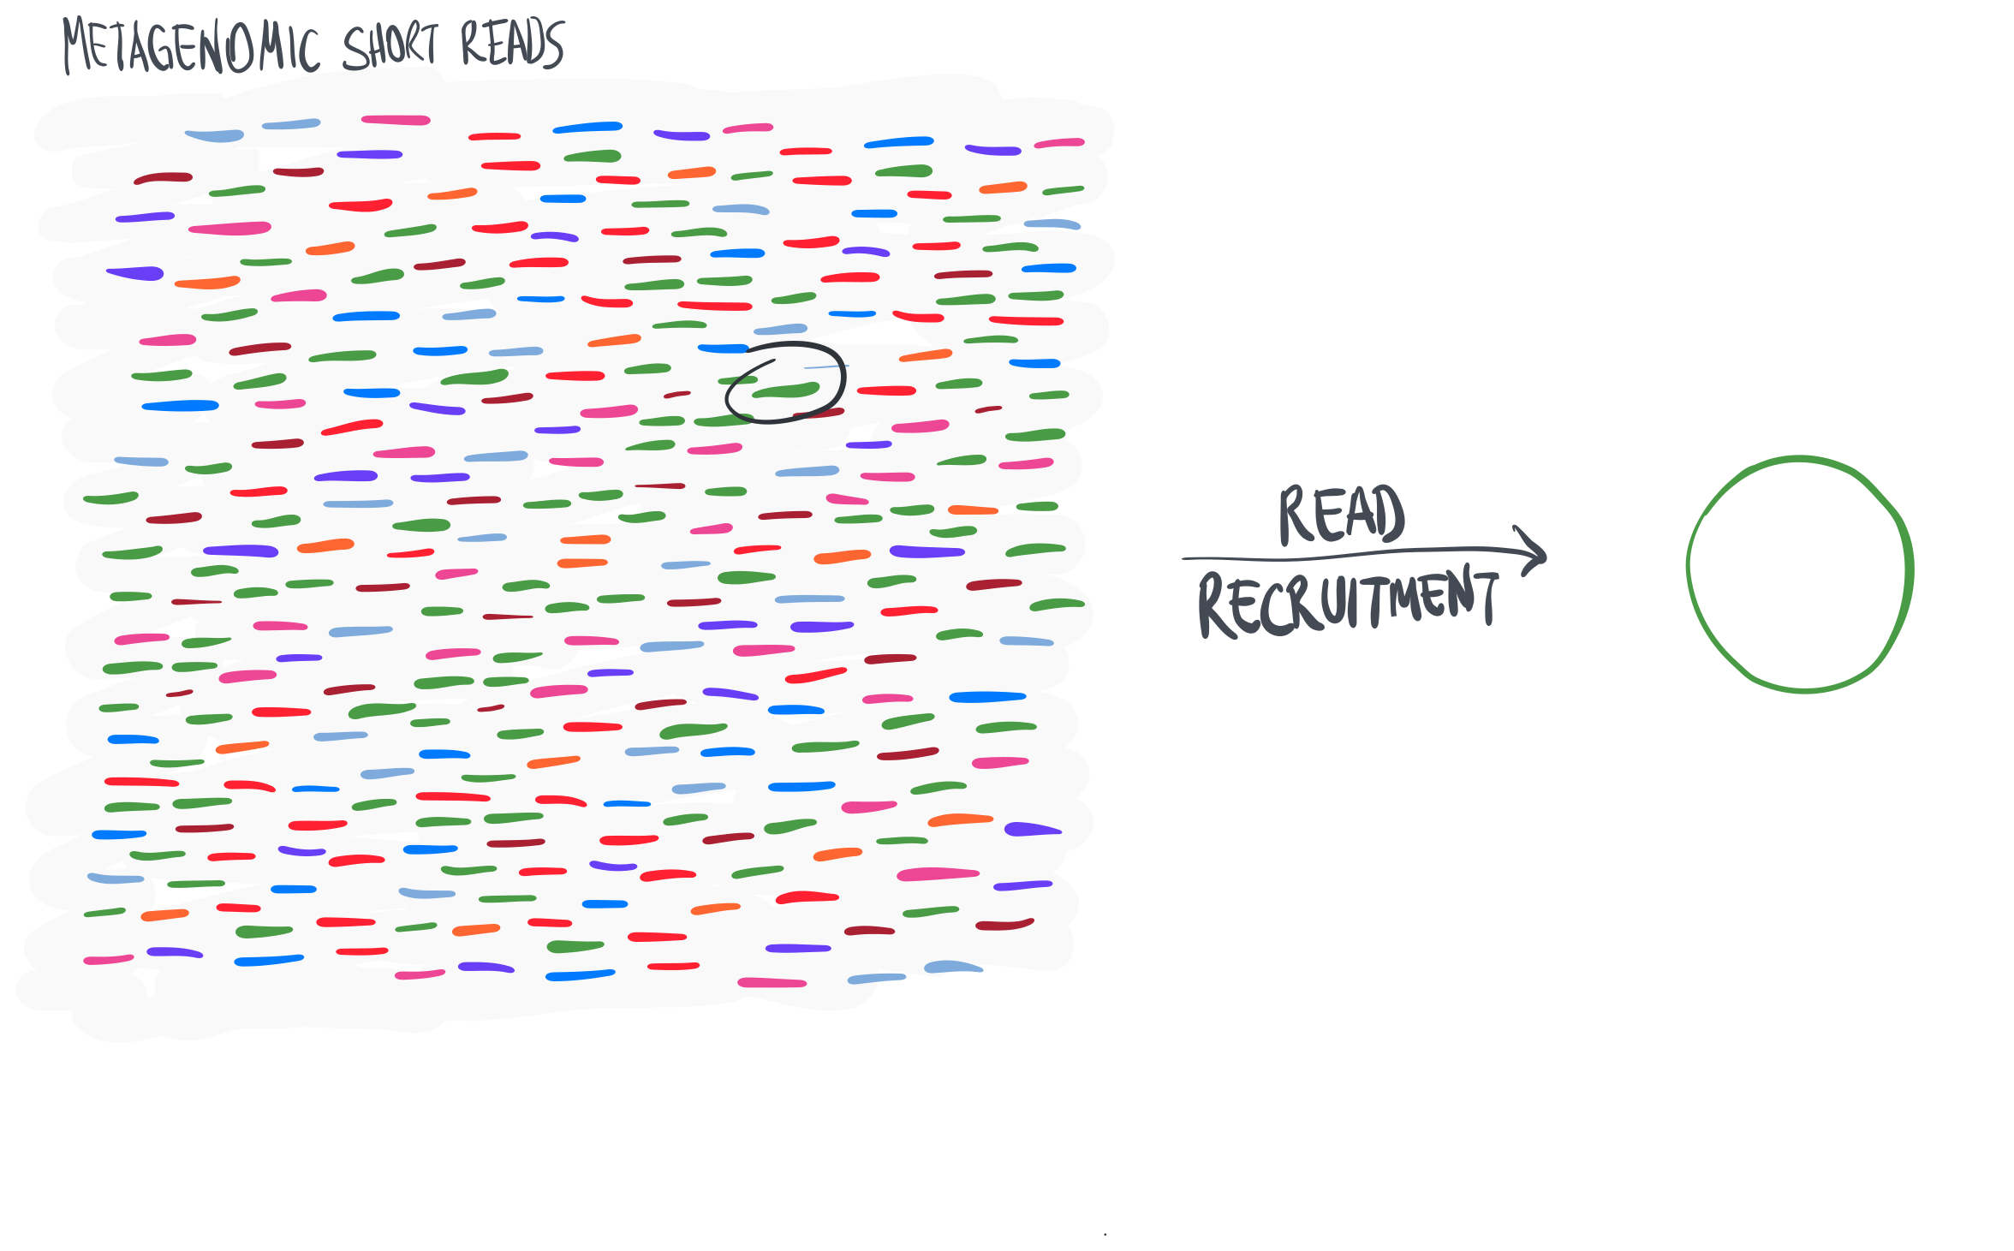

Slide 6
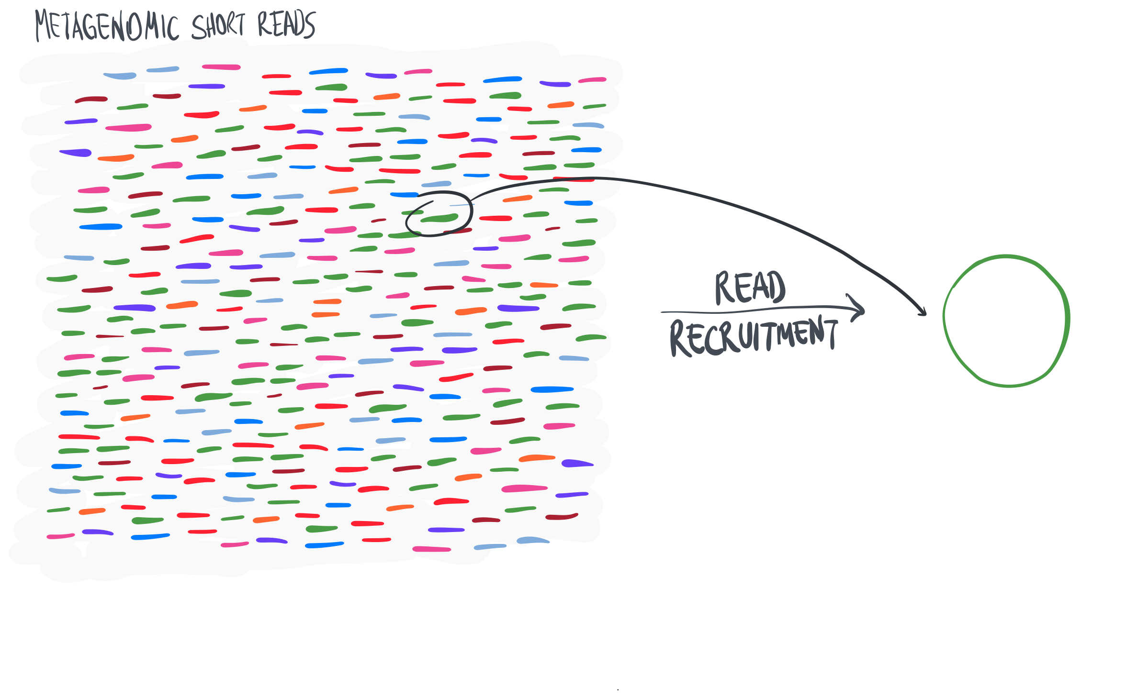

Slide 10
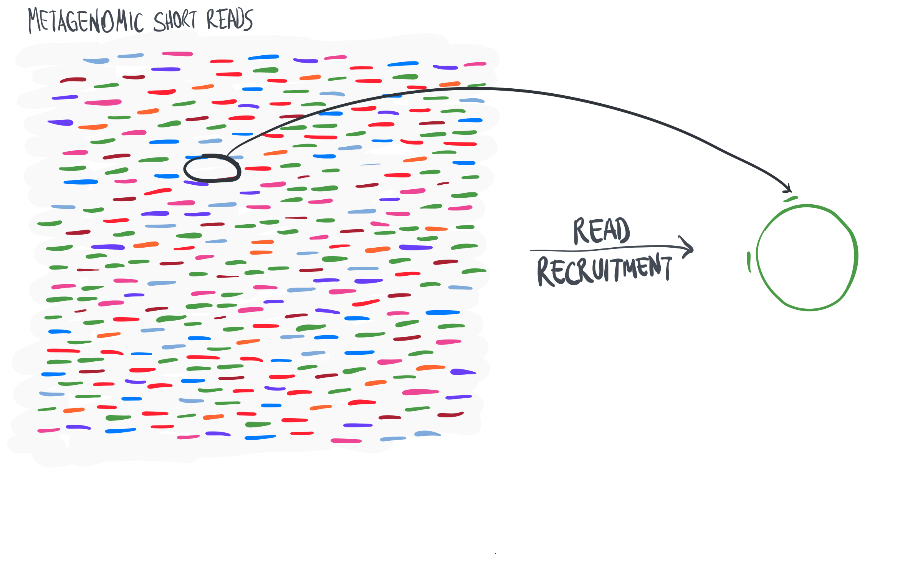

Slide 11
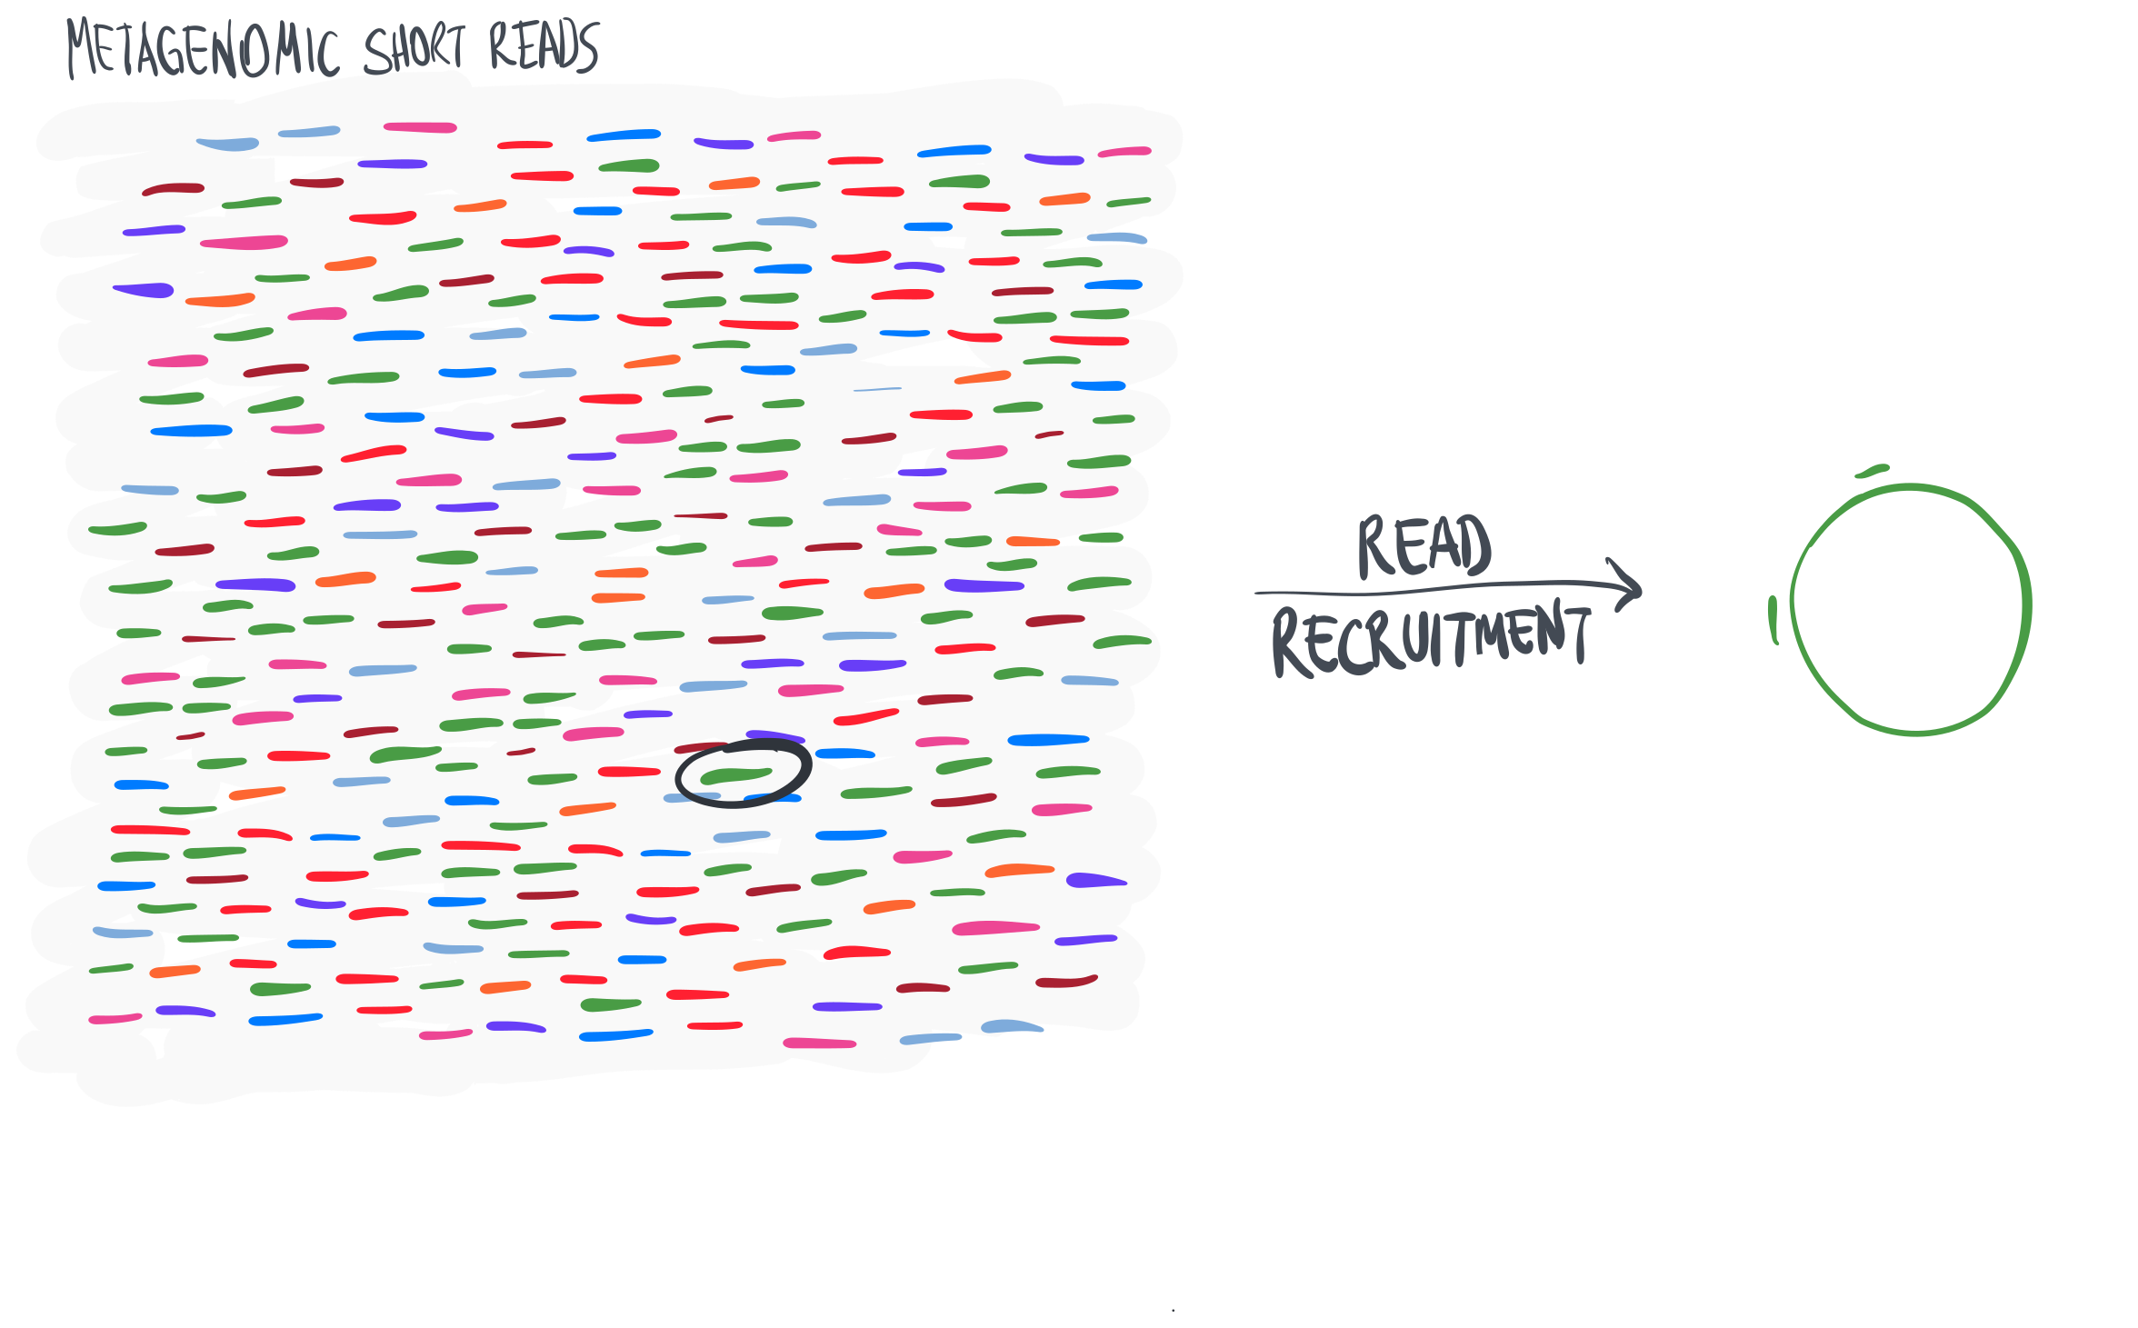

Slide 17
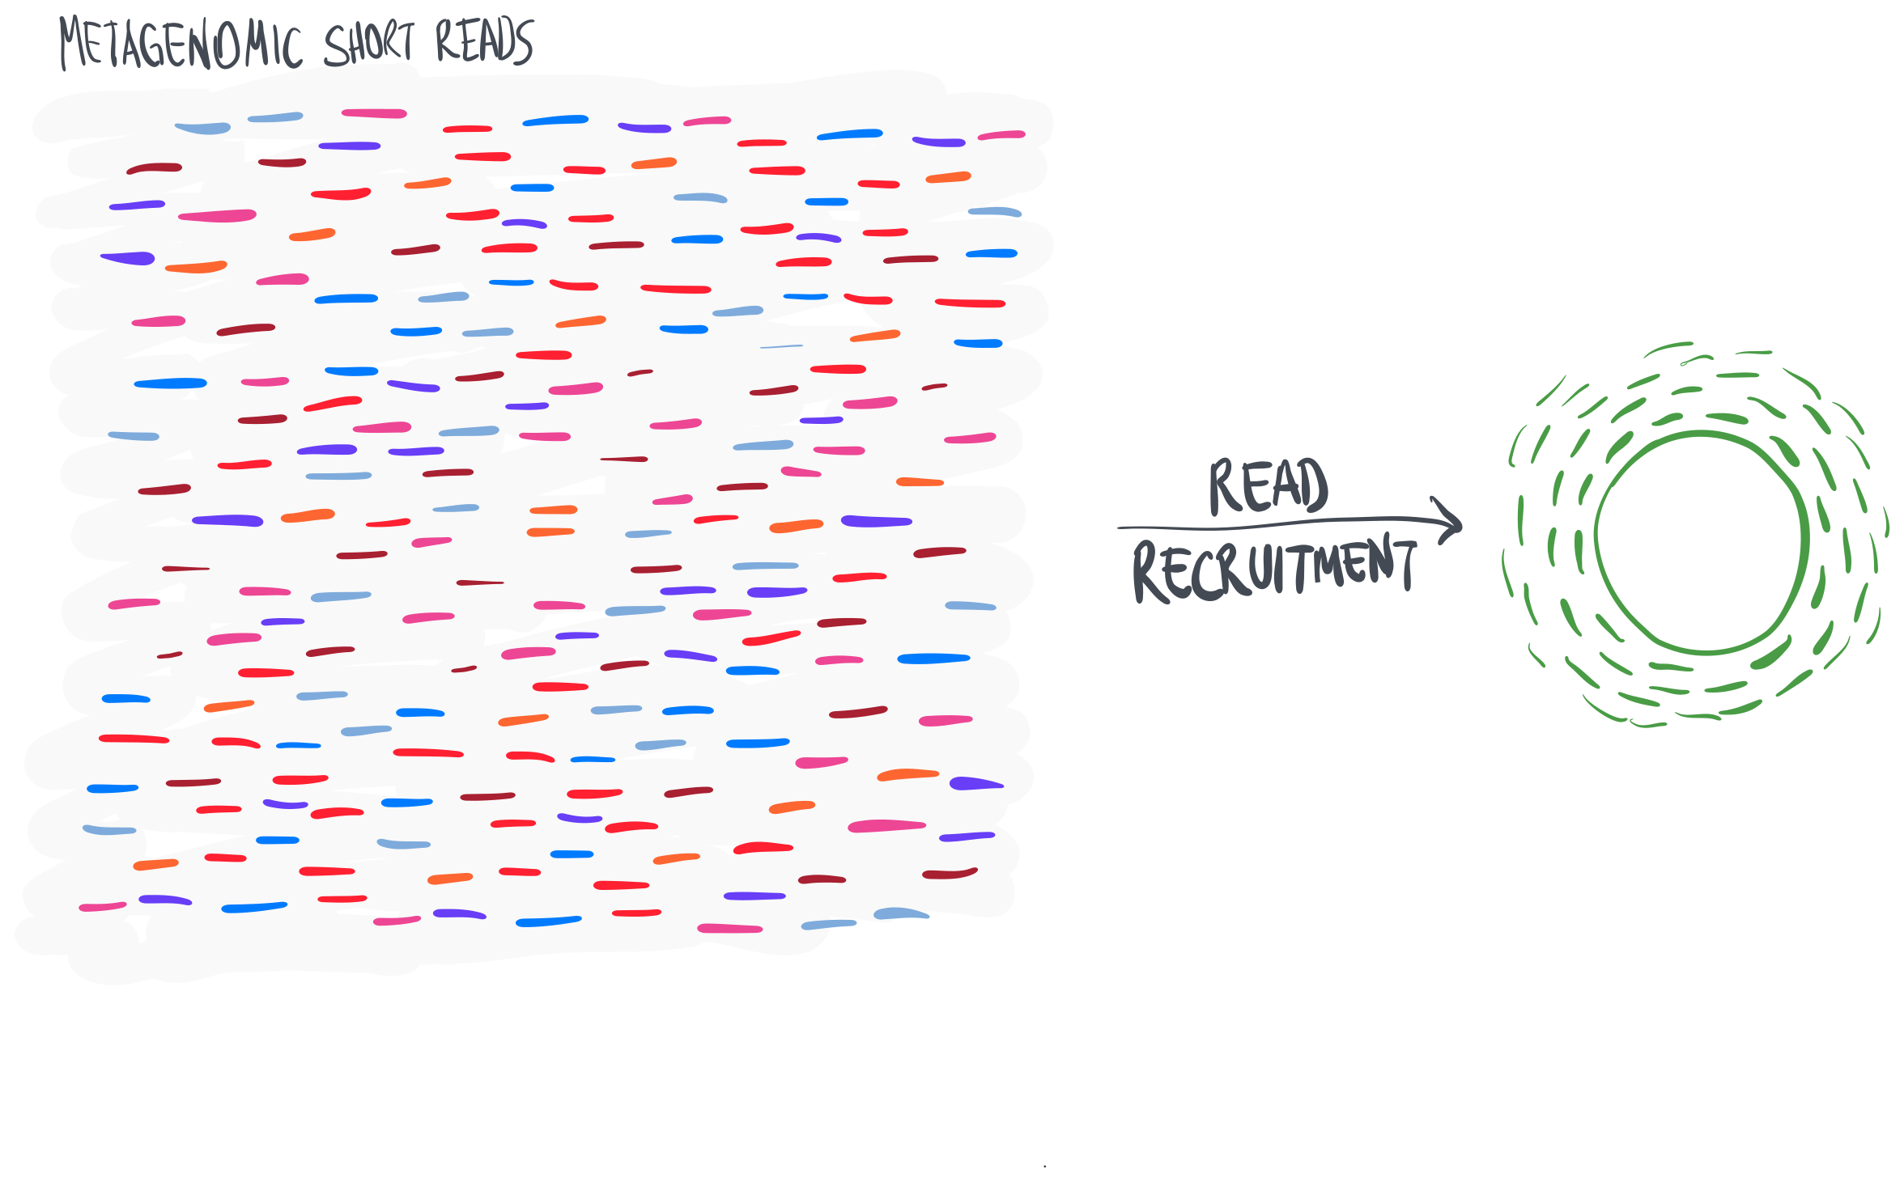

Slide 19
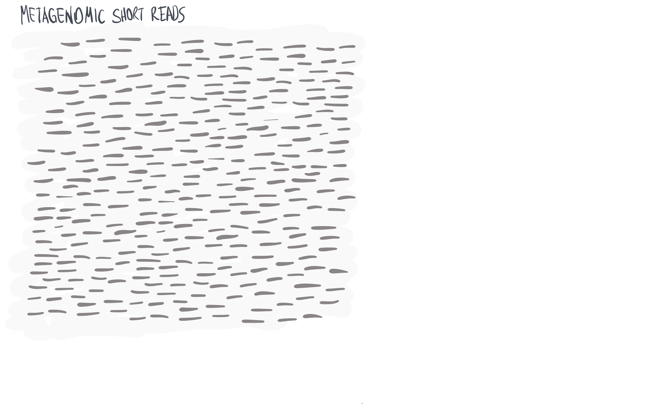

Slide 20
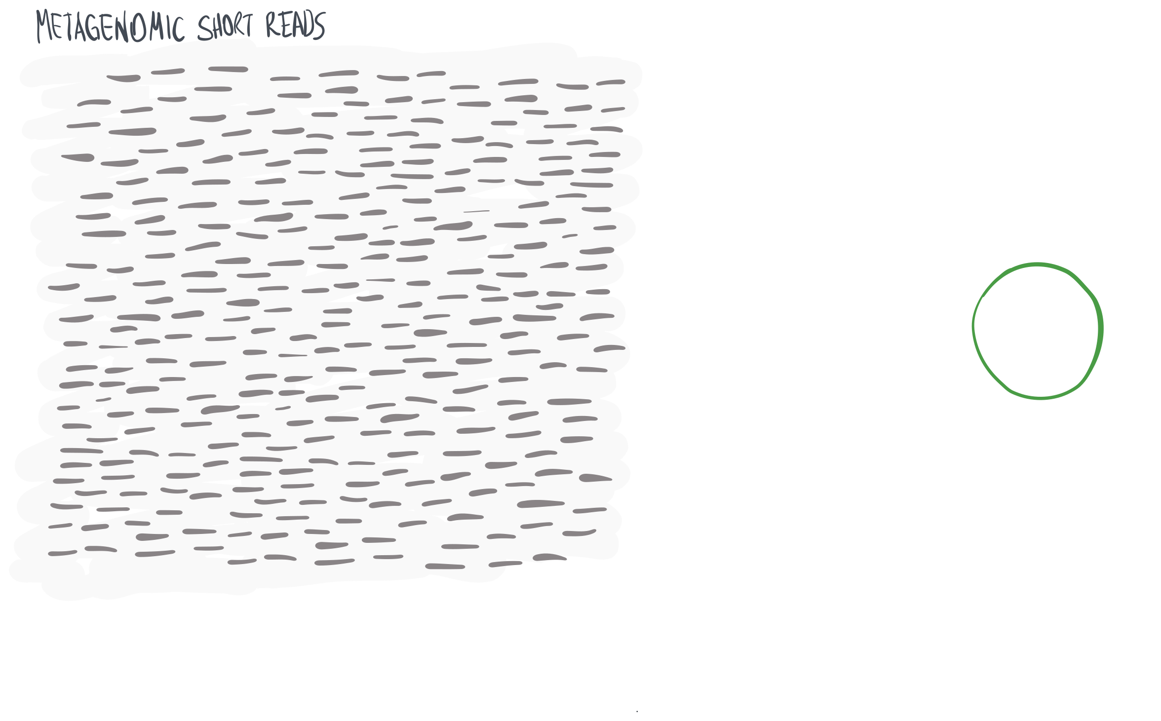

Slide 21
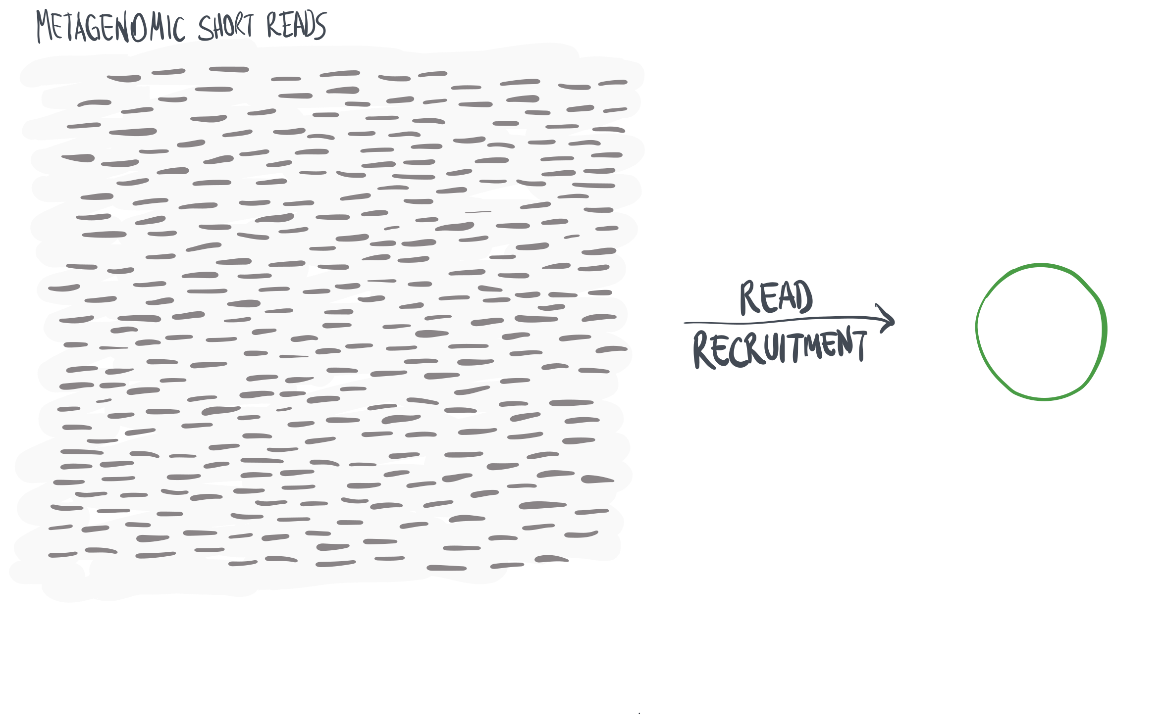

Slide 22
