Slide 1
Computing k-mer frequencies
(a simple example with k=2)
http://merenlab.org/momics

Slide 19
Notes:
But how about the reverse complement of this sequence?
Q: Why should we care about reverse complements of contigs?
Because the assembler can report contigs from the same genome with different directions!
Q: Why? :)

Slide 21
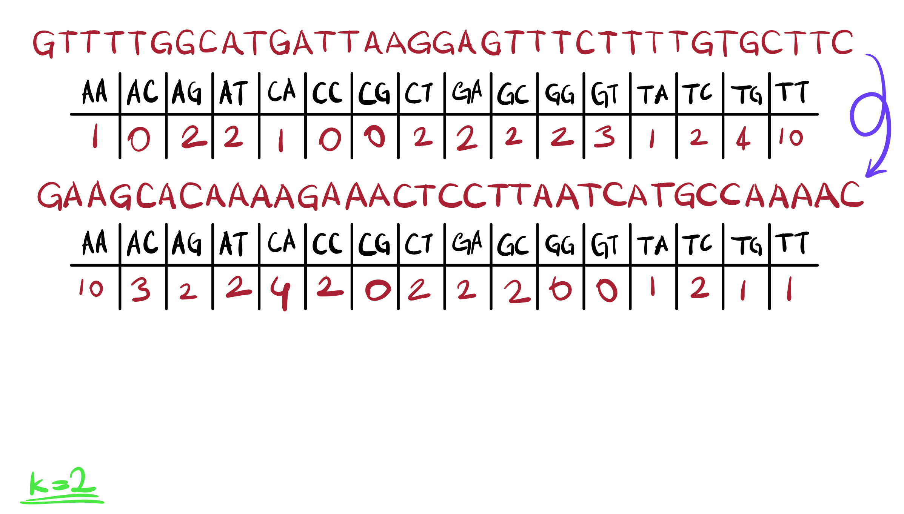
Notes:
For instance, the reverse complement of the same sequence will have different 2-mer frequencies.

Slide 22
Notes:
Q: what would be a strategy that can take into consideration both strands in one pass?

Slide 23
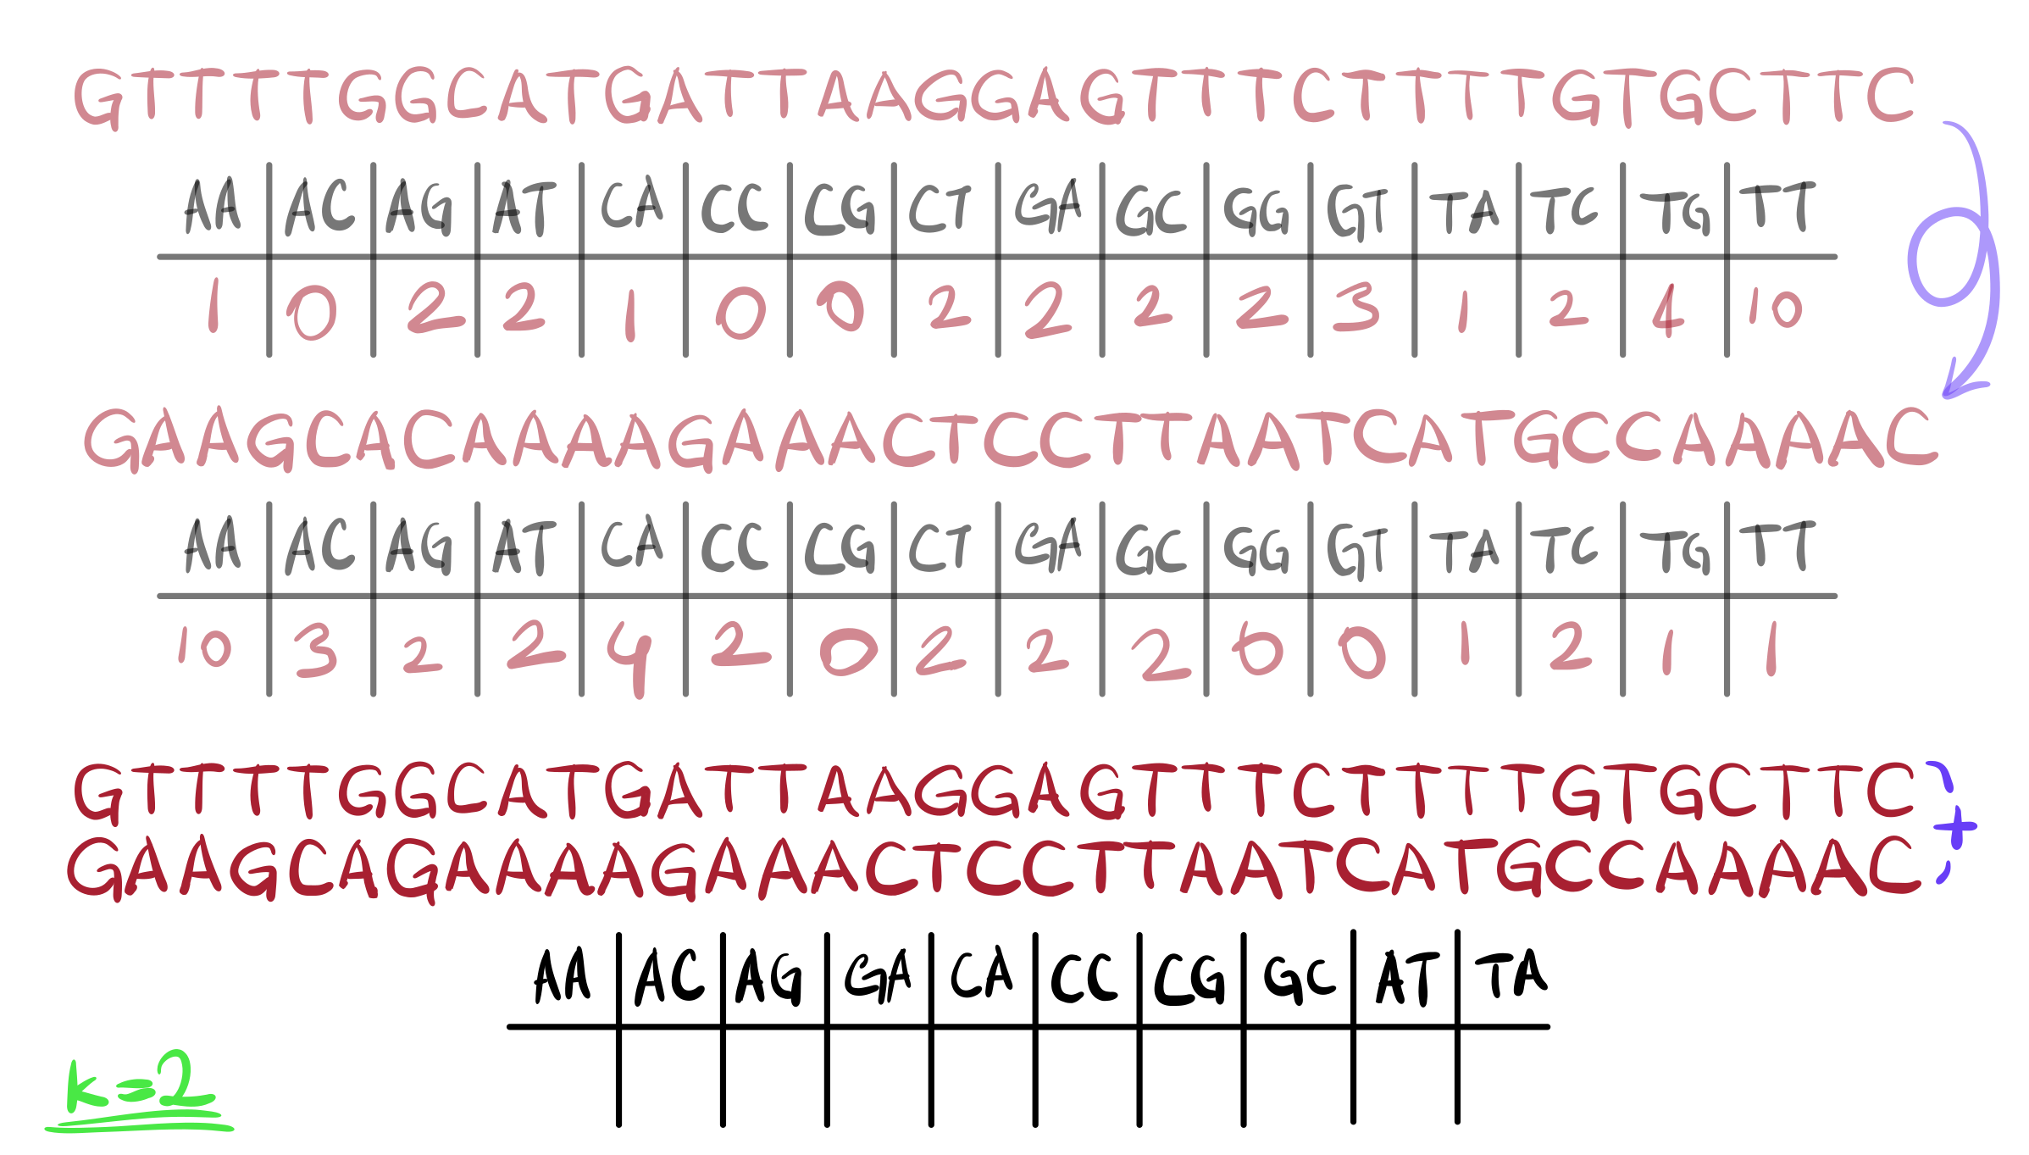

Slide 24
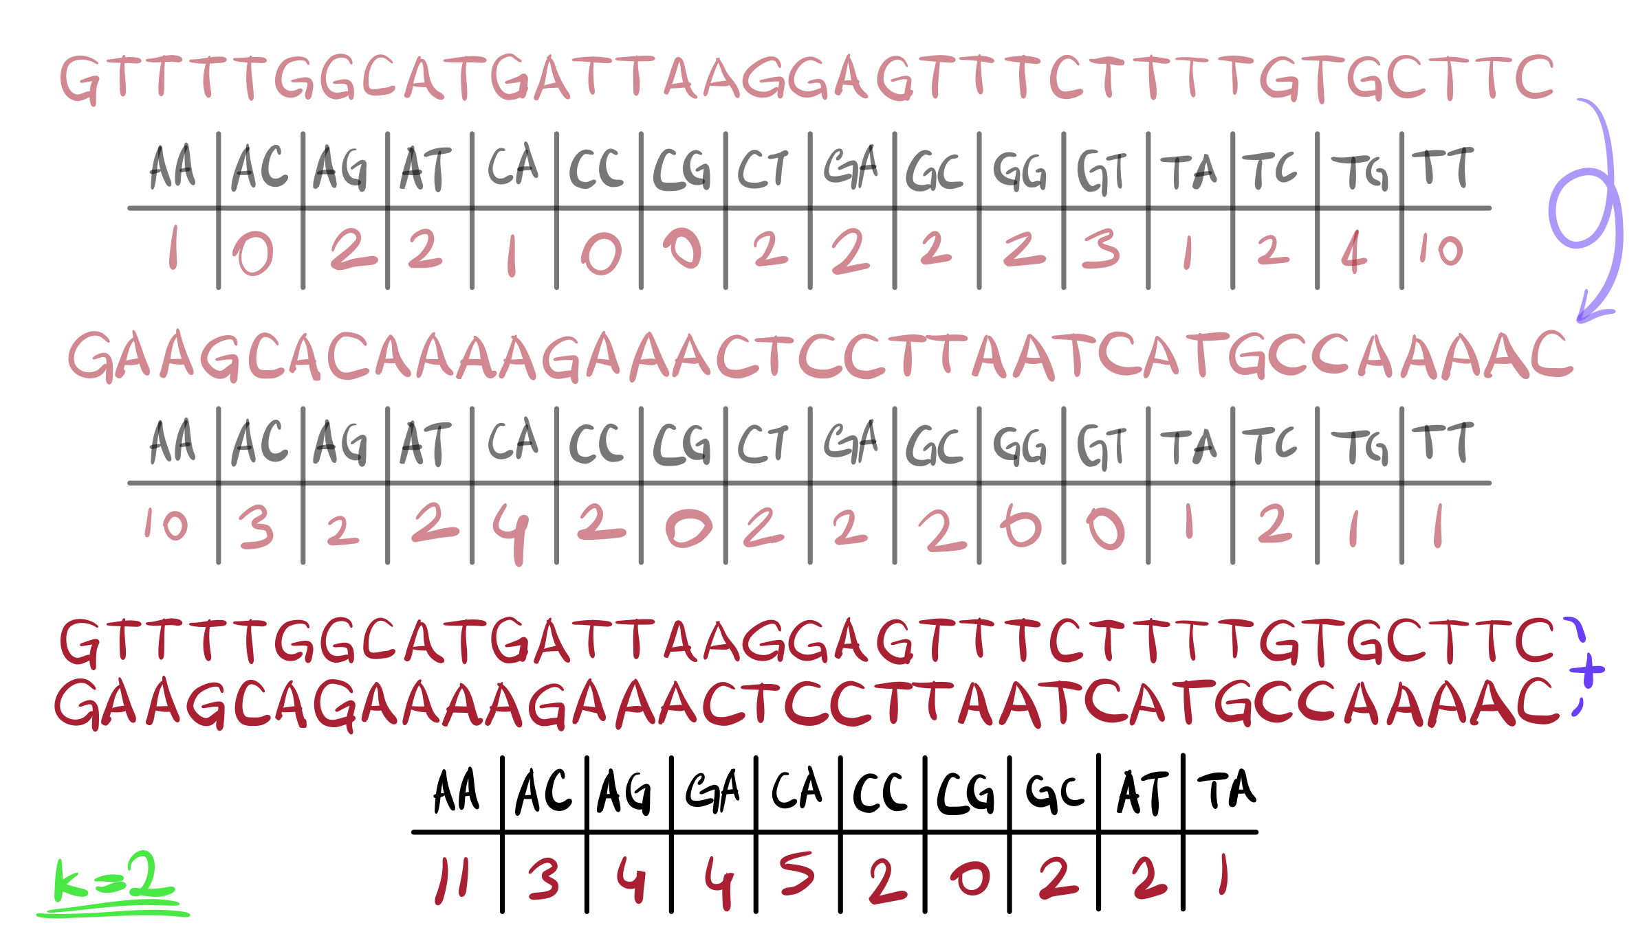

Slide 25
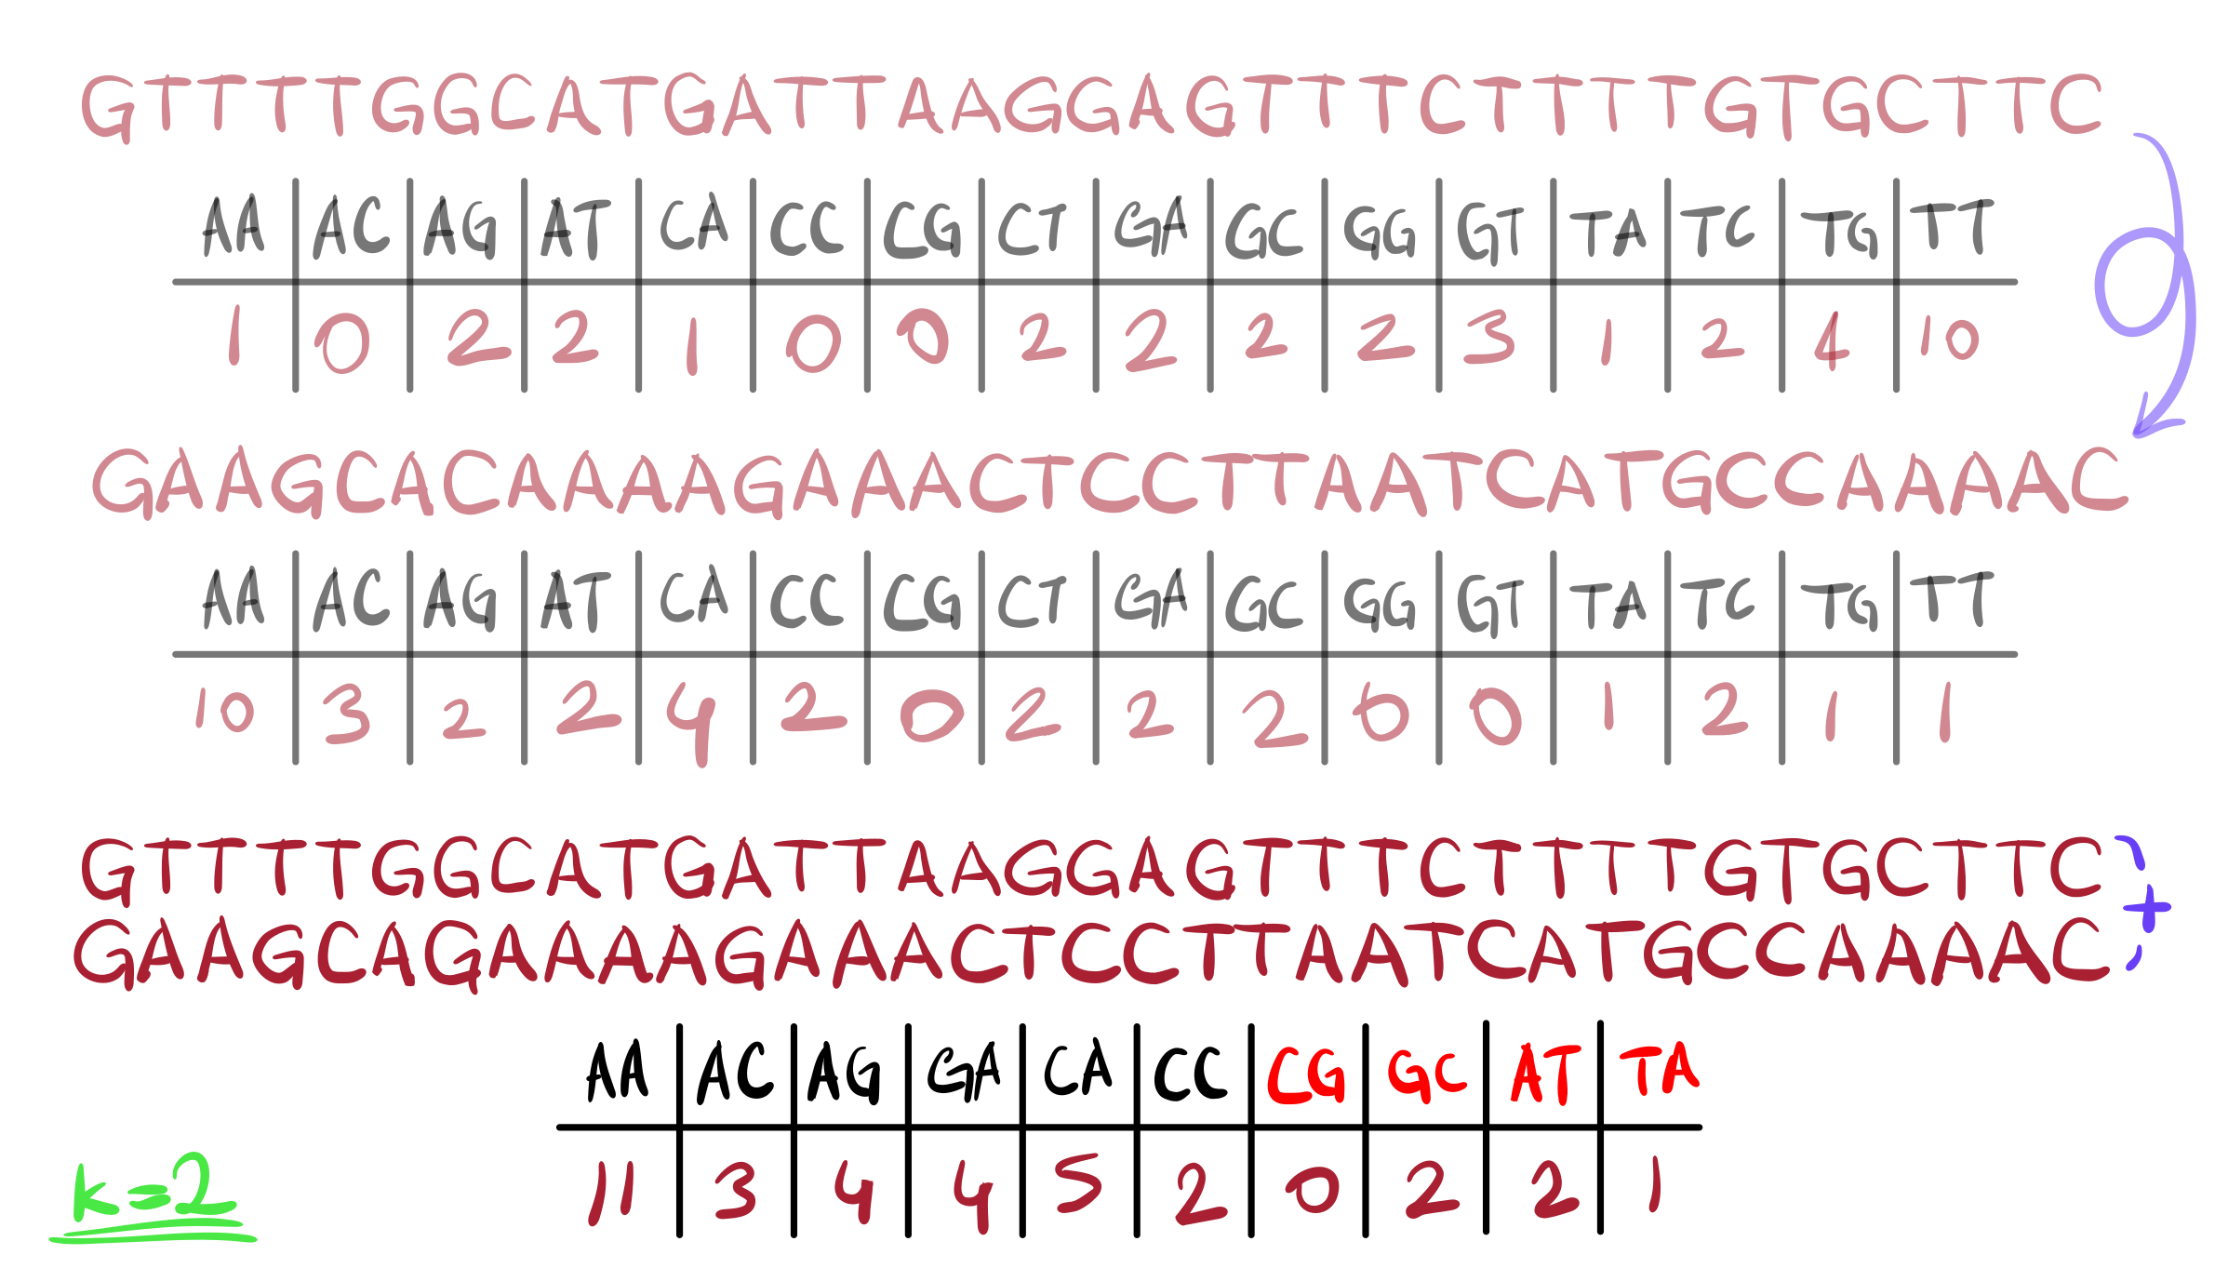

Slide 26
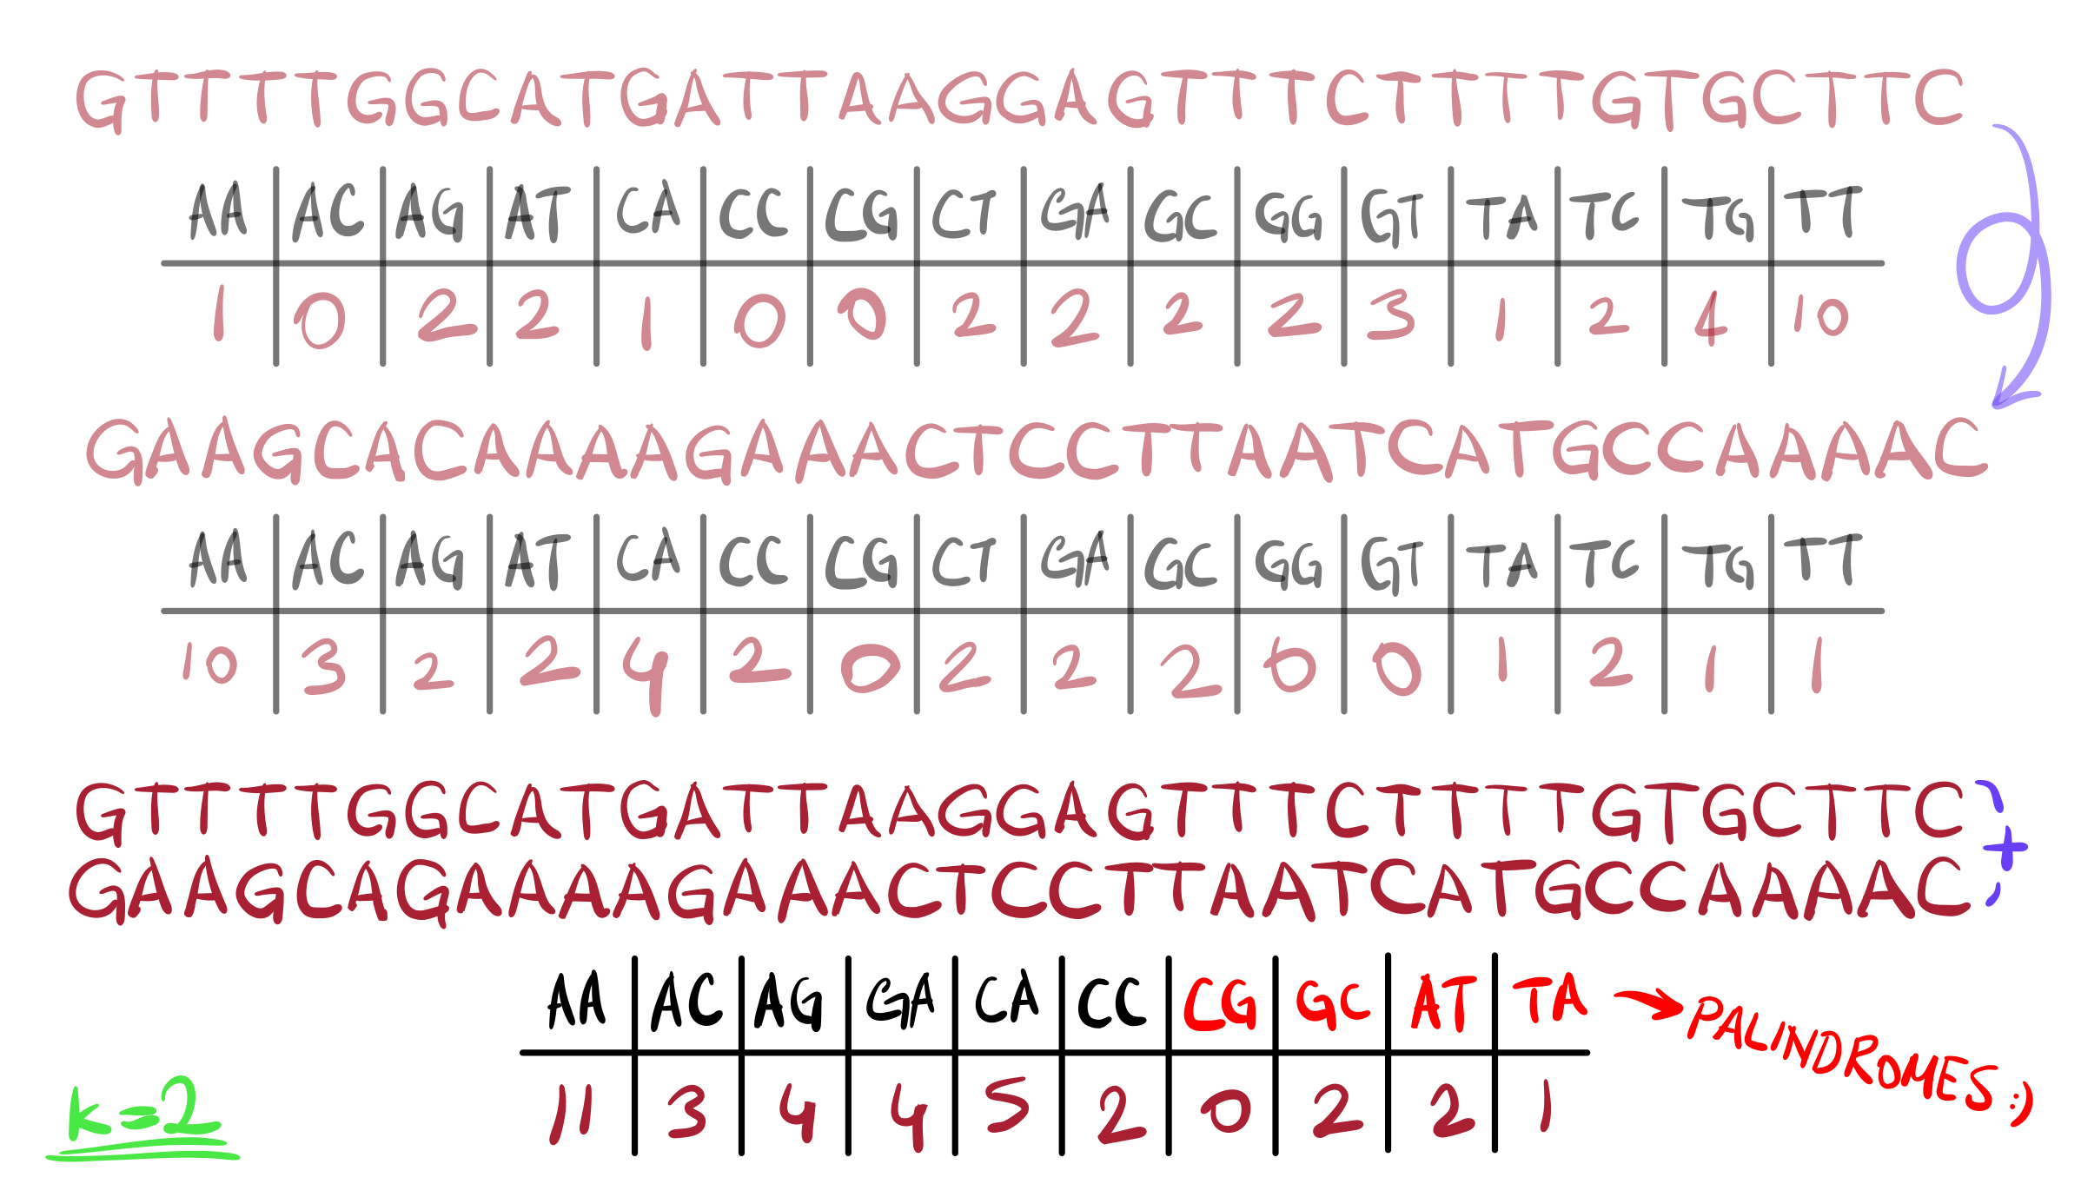
Notes:
Totally irrelevant note, palindromes are a big deal in literature and linguistics. My favorite palindrome in English is “Was it a car or a cat I saw?”
Q: Can you imagine what happens when we have multiple sequences?

Slide 28
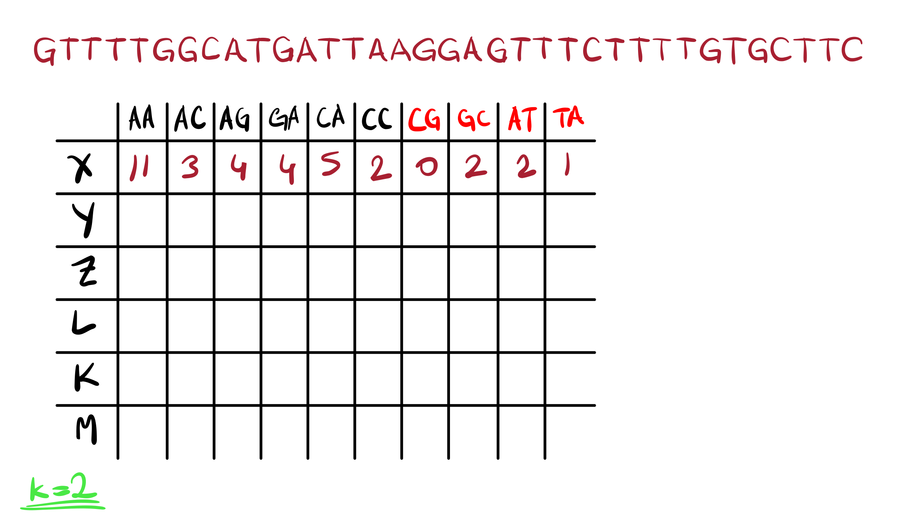

Slide 29
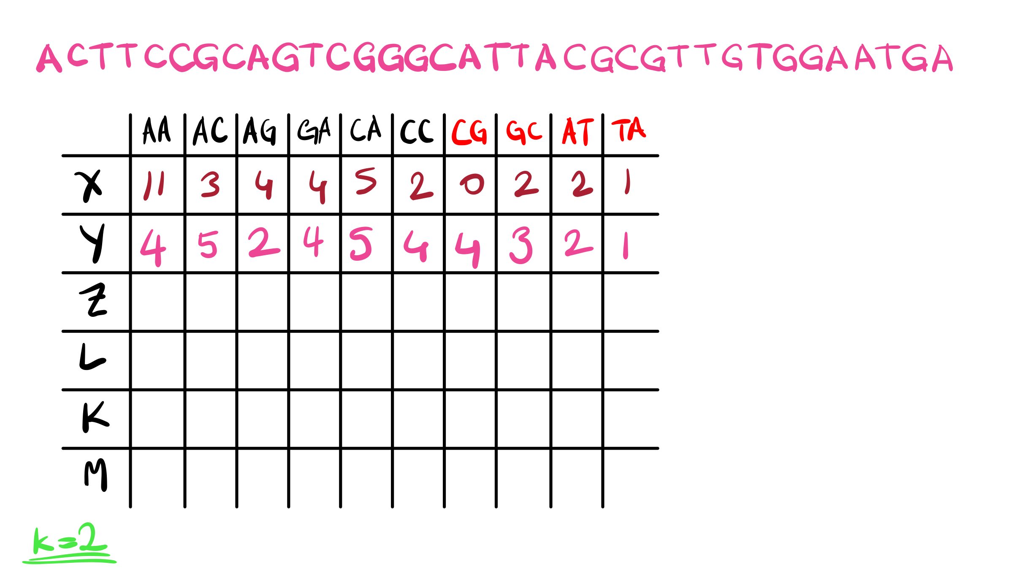

Slide 30
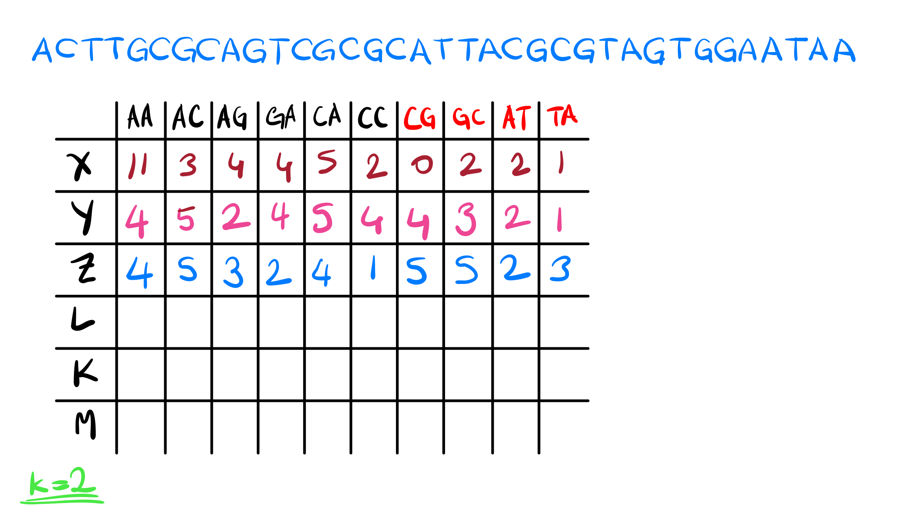

Slide 31
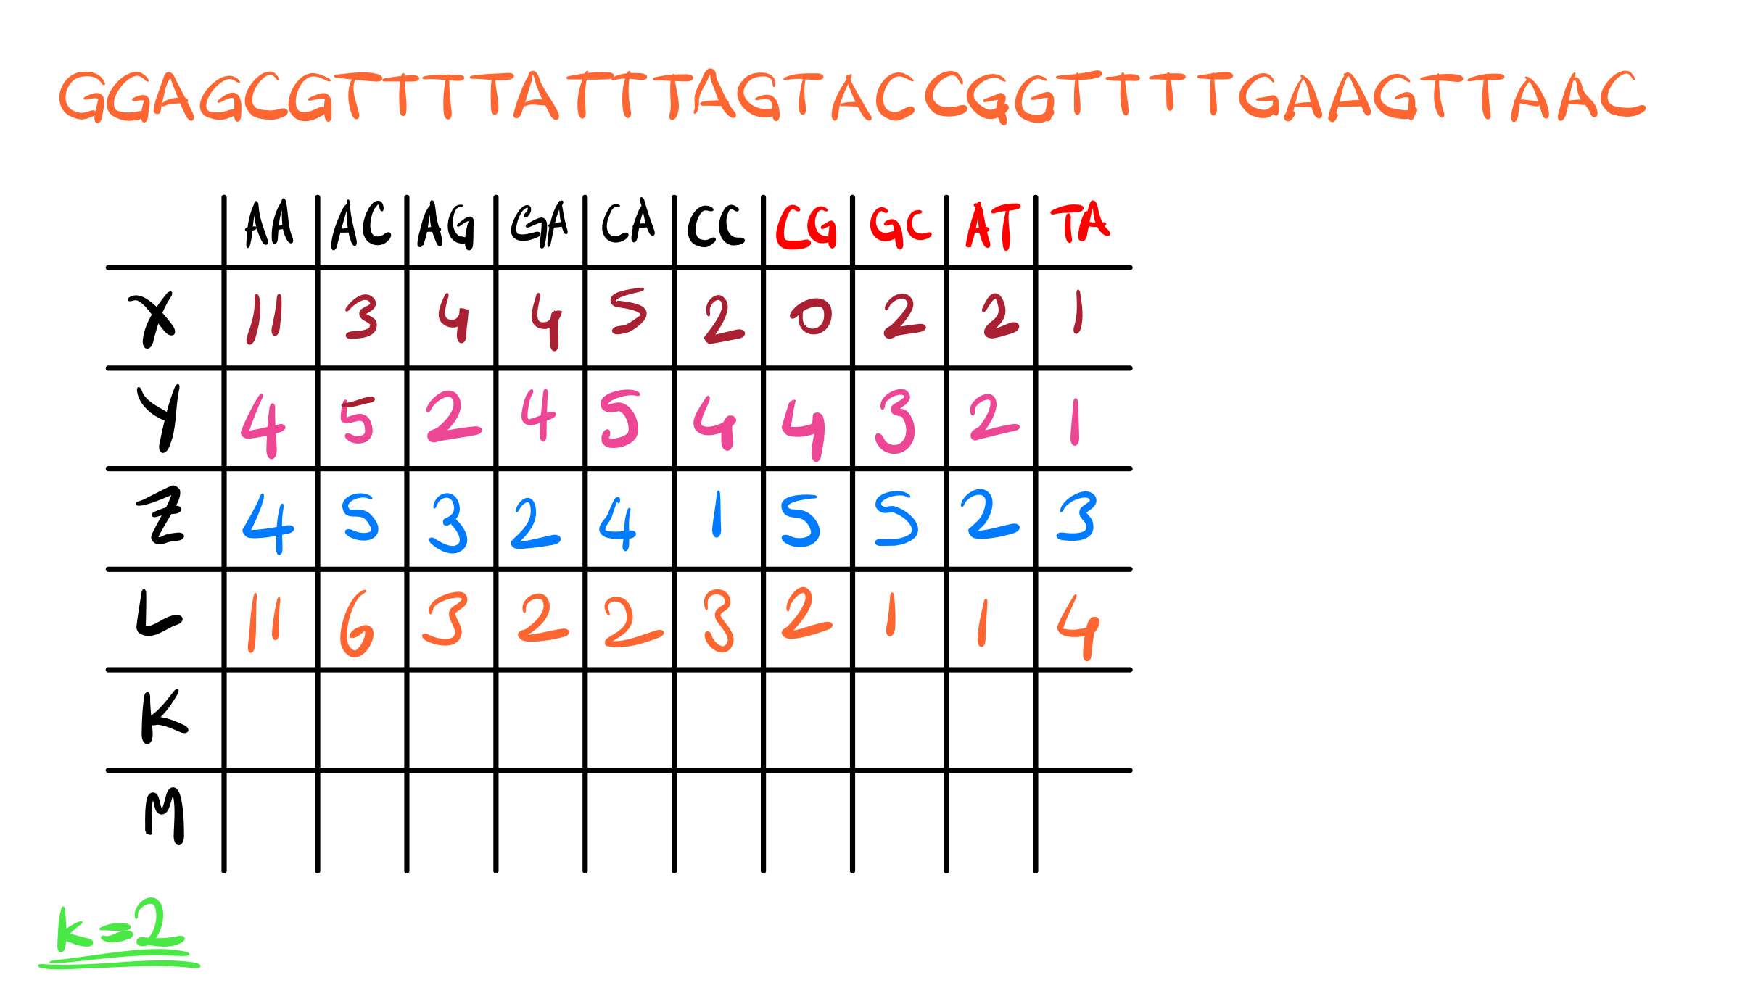

Slide 32
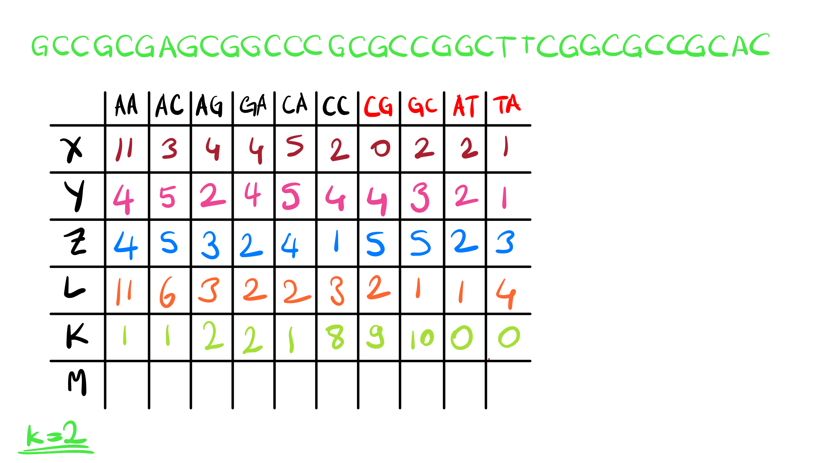

Slide 33
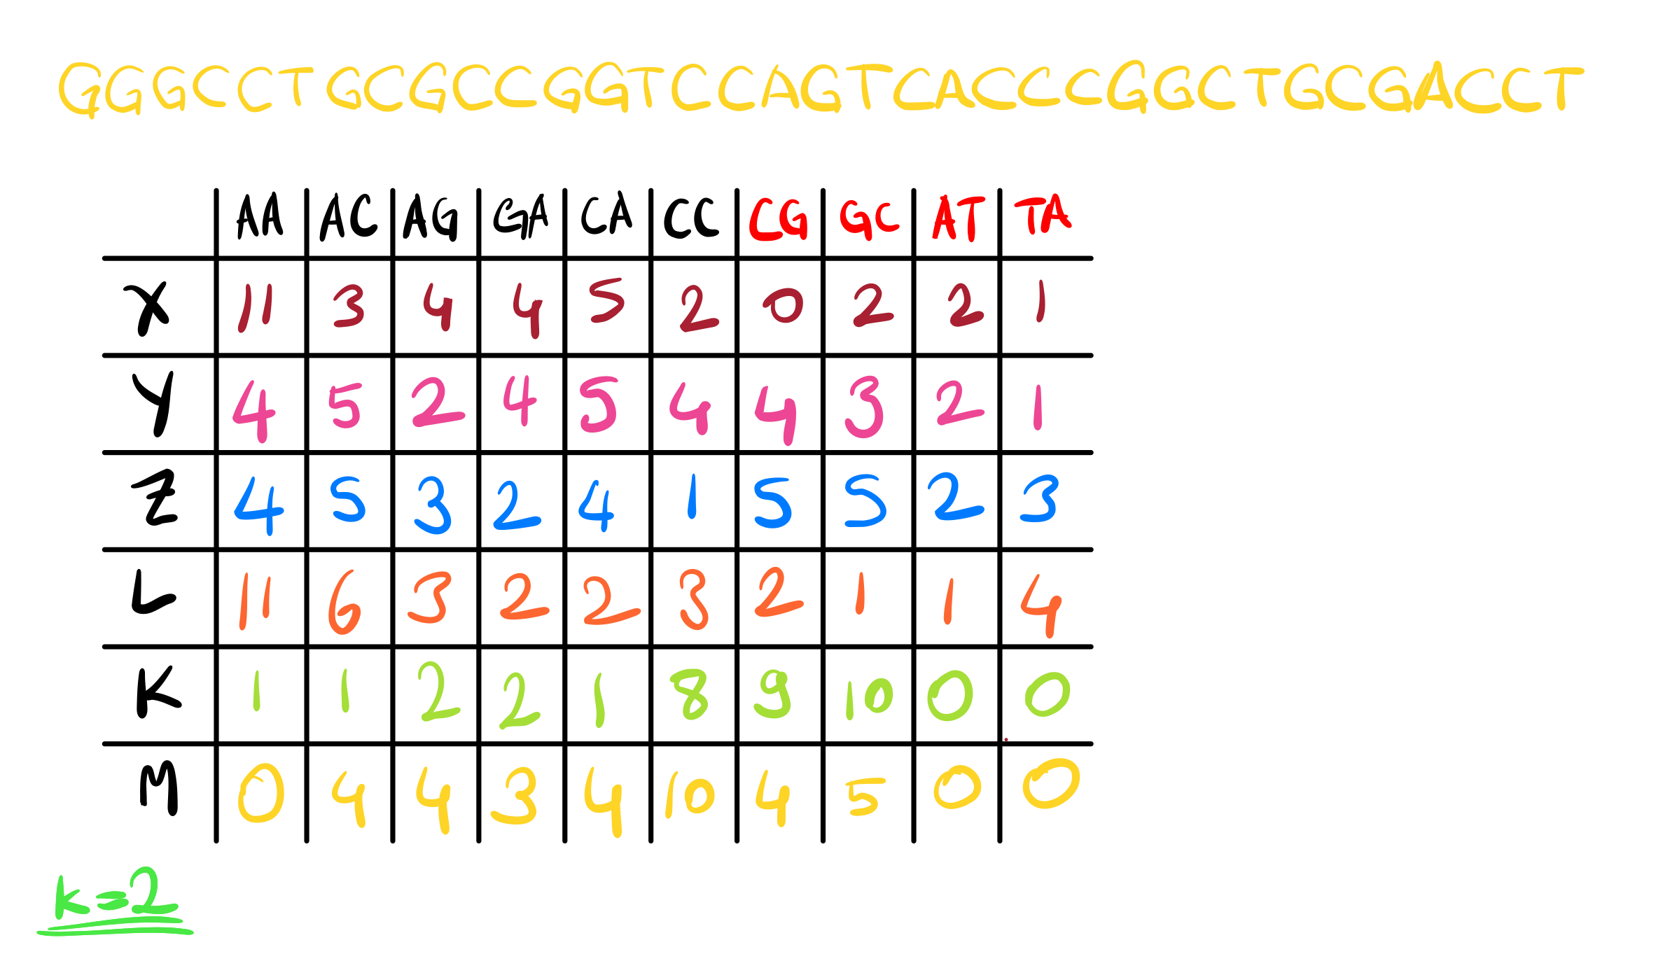

Slide 34
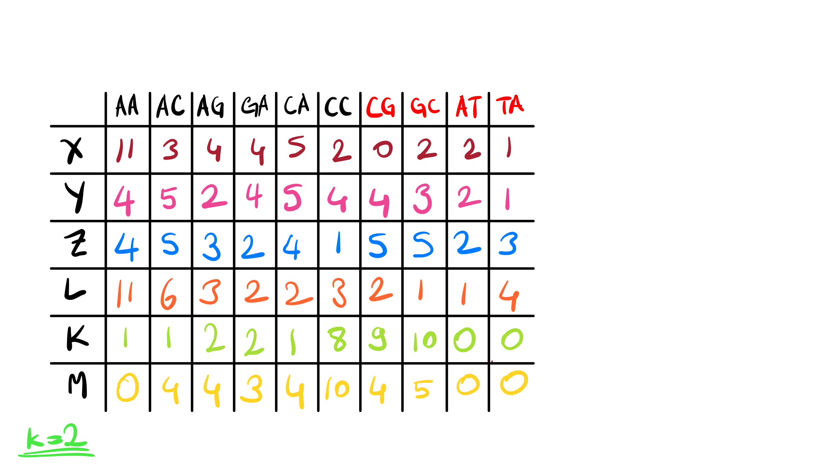

Slide 35
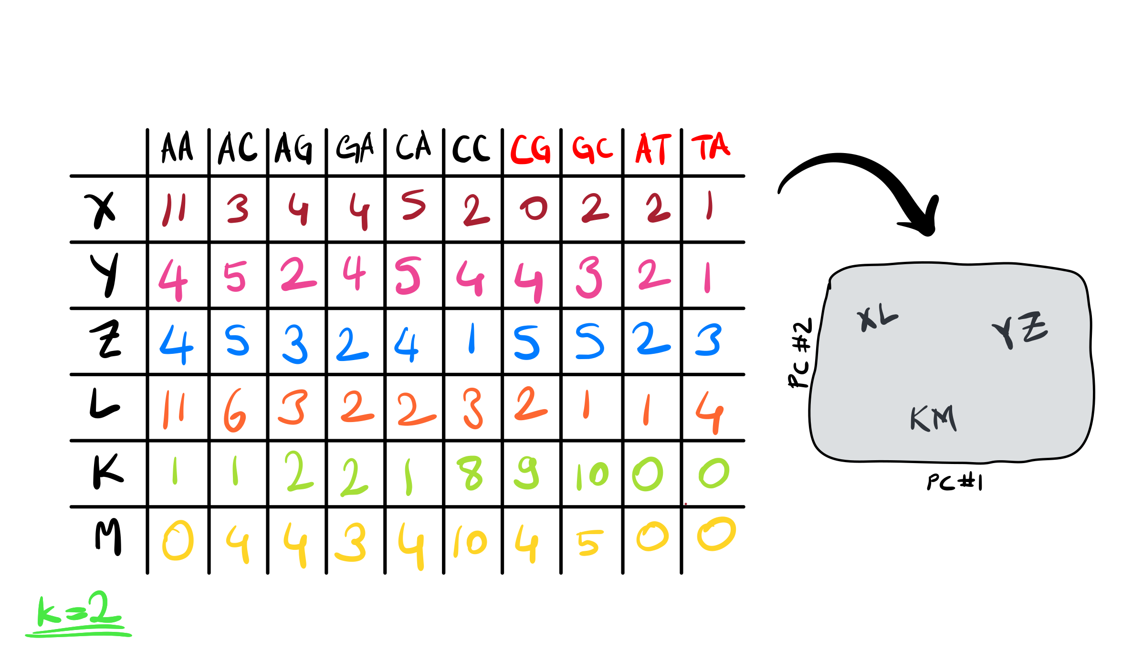

Slide 36
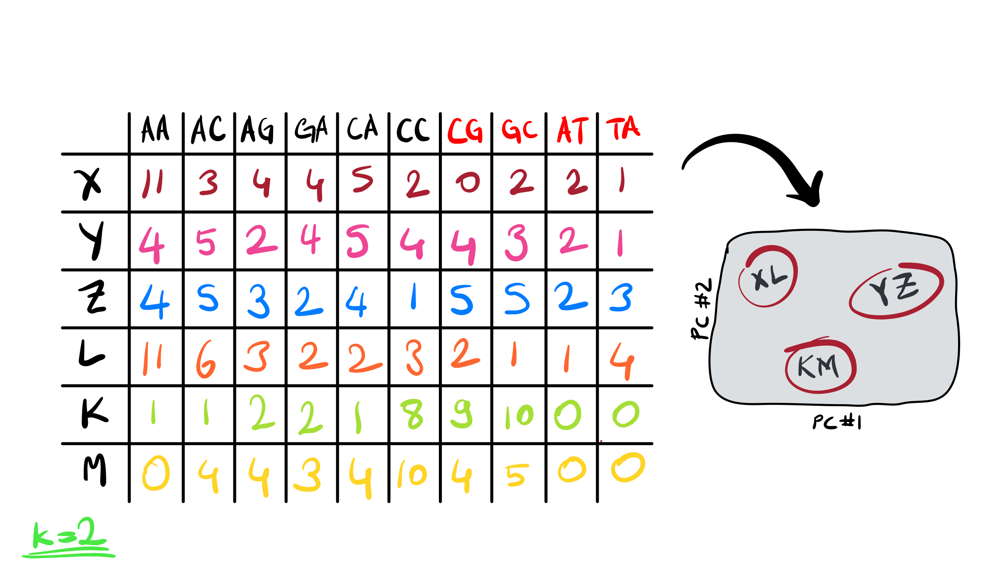
Notes:
What are the other advantages of this strategy?

Slide 37
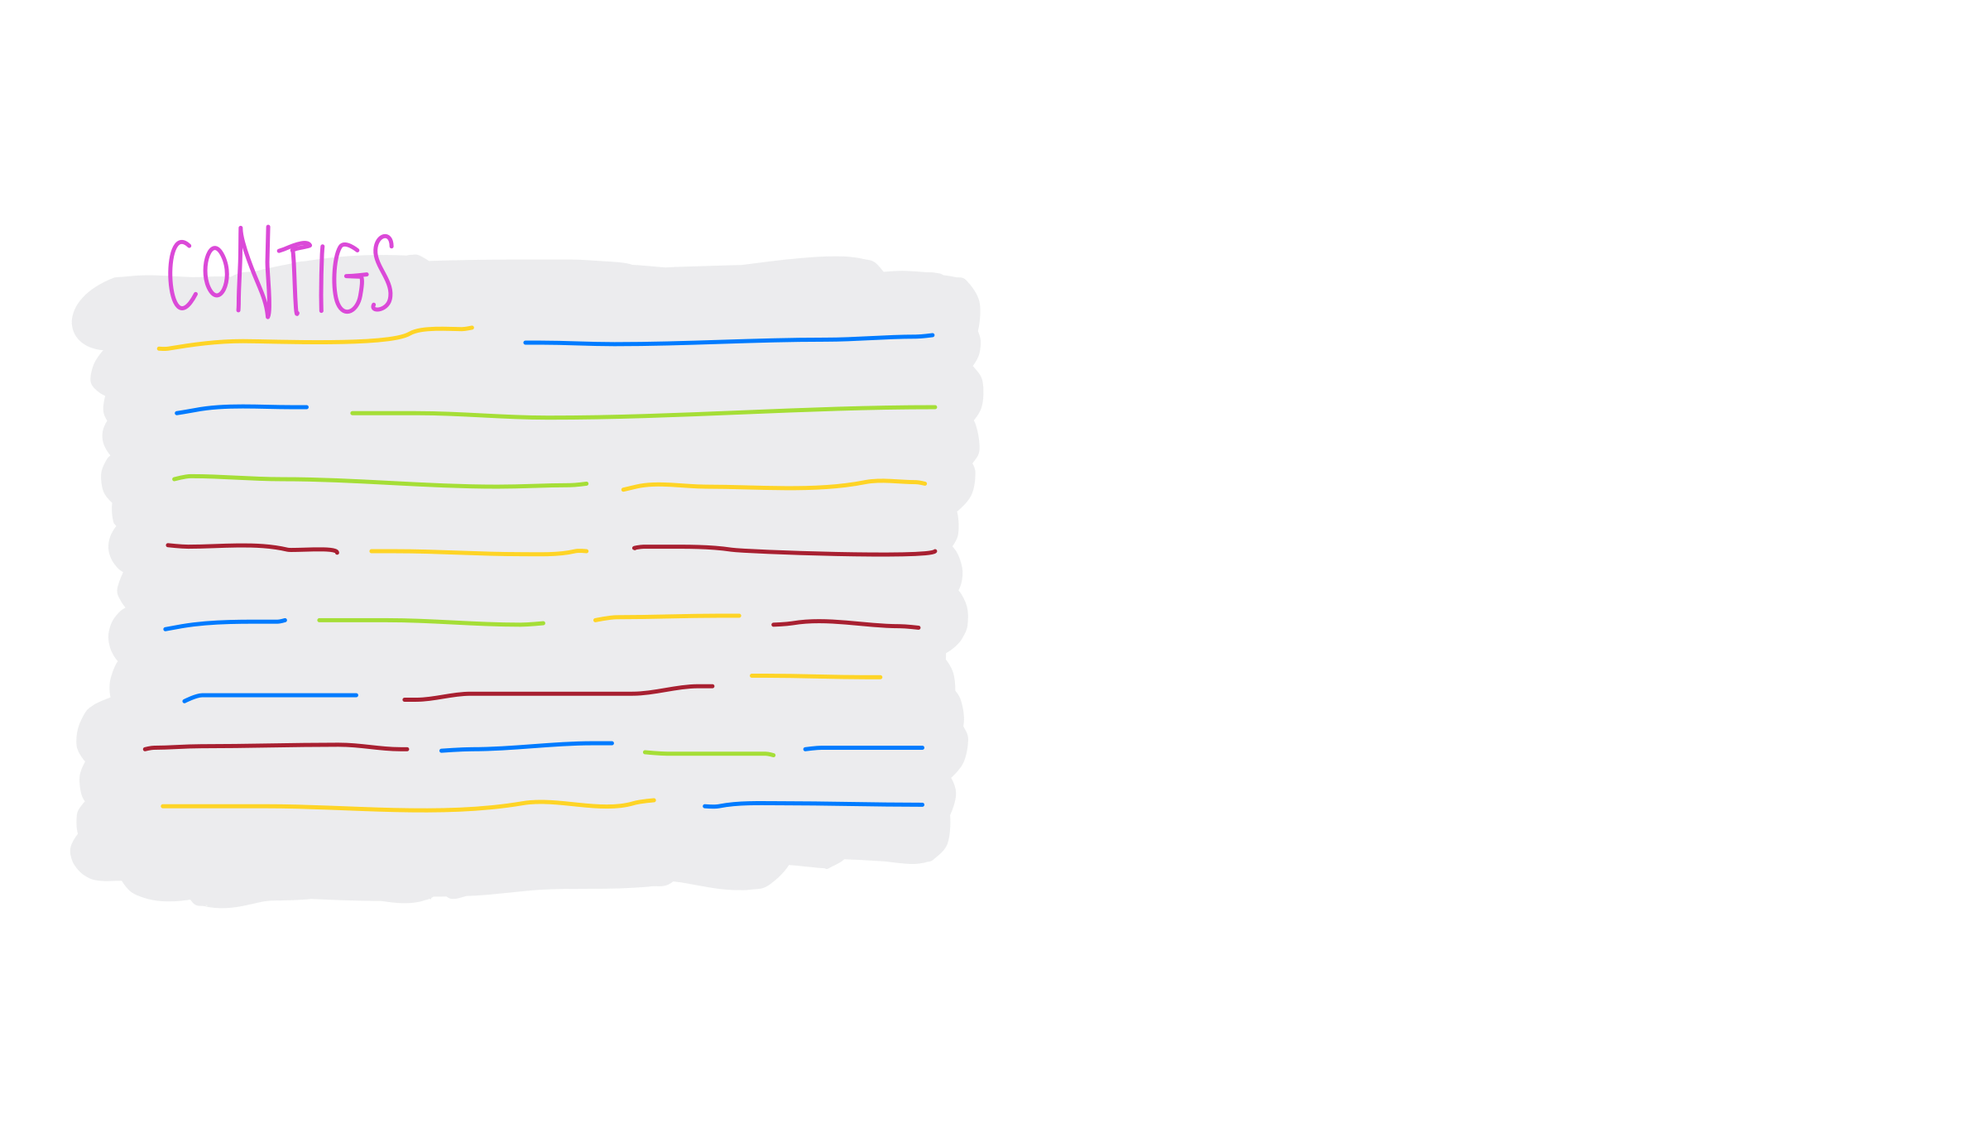

Slide 38
